Slide 1



Small Teaching Strategies
To enhance memory, attention & engagement
Dr. Chris Mattatall
GoodTeaching.ca

Slide 2
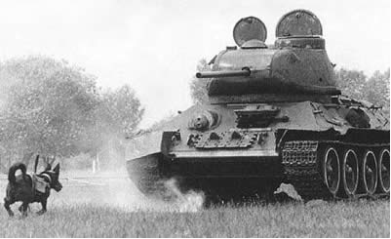
Notes:
So, I’m going to start here 1942
1942 Dog-bombs were used to stop German invasion of east front. The plan backfired because the dogs were trained with Soviet tanks. When the battle actually occurred, the dogs simple did not recognize the enemy tanks.
-they were highly motivated....they were starved.
-they were highly trained....for months...they knew exactly what they were supposed to do.
The problem....they did not recognize the proper target.
Today, I want to discuss with you what the proper target: Learning
Not teaching, but learning. Subtle difference? Maybe.

Slide 3

What is our target in
teaching?
Notes:
What is our target in teaching?
It’s learning. It’s not even good teaching or being a good teacher, or talking, or instructing, or curriculum, or any of those other things....albeit very important. Our target is learning.

Slide 4
Small Teaching Strategies
To enhance memory, attention & engagement
Dr. Chris Mattatall
GoodTeaching.ca
Notes:
Today in this session I want to bring forward the concept of small teaching strategies that you can put in place on Monday and see effect on memory, attention and engagement right away.

Slide 5
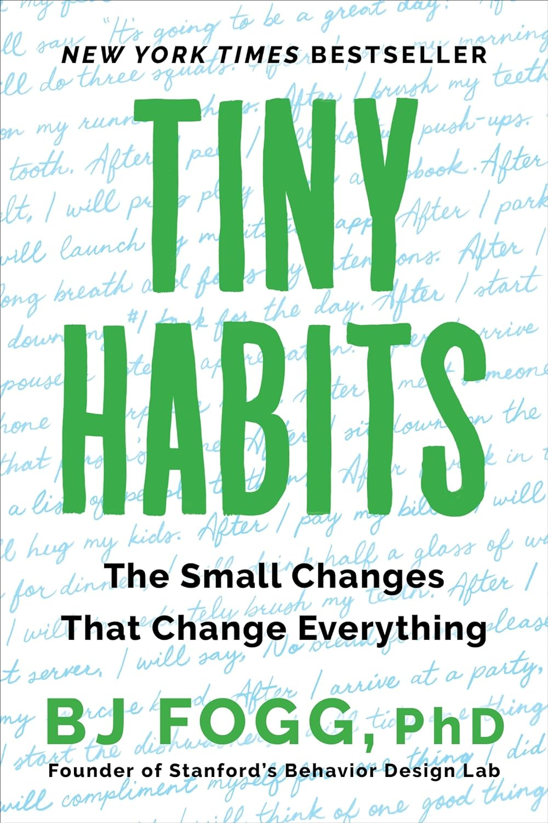
It’s February 23, 2024
How many of you made a New Year’s Resolution this year that you’ve already broken?
Notes:
The concept of Small Teaching comes from the idea of tiny habits....new habits are likely to stick if we pin them to existing behaviours or moments in our life....instead of making giant and uncommon changes to our lives, we add one small change, linked to our current practice and over time build up tiny habits.
Tiny is powerful. Tiny is safe. Tiny is doable. Tiny is achievable.

Slide 6
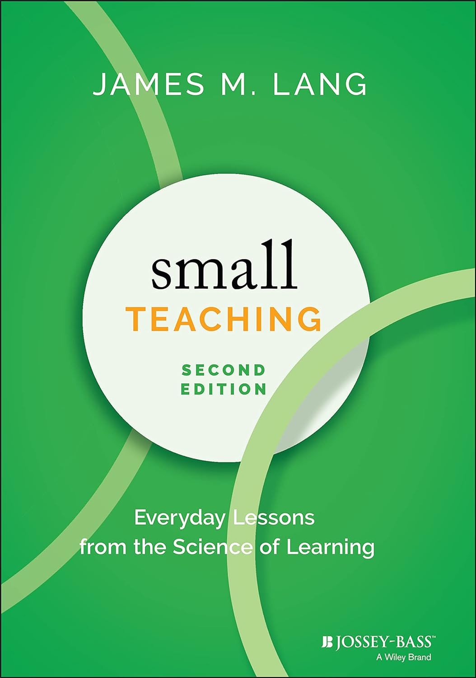
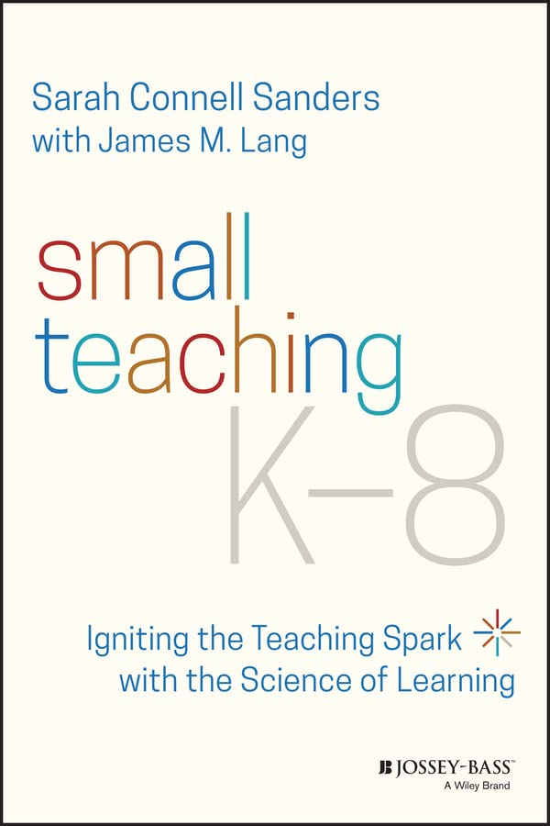
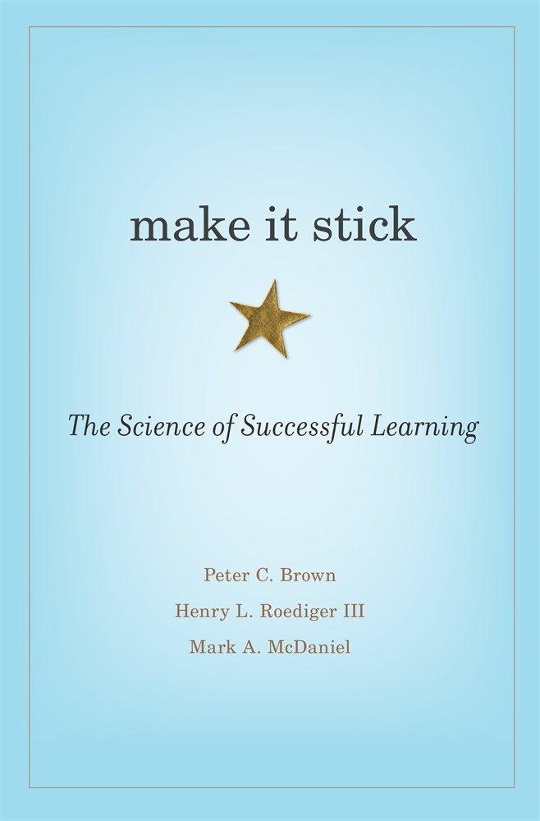
Notes:
After reading Fogg’s work, Dr. James Lang, a Professor of English and Director of the Center for Teaching Excellence at Assumption College, wrote Small Teaching.
His thinking, “use research from the learning sciences to offer teachers small, practical changes they can make to their teaching to improve student learning. The idea here, of course, is to add these tiny teaching approaches to what you are already doing...punctuate your teaching with research informed ideas to help students learn.

Slide 7
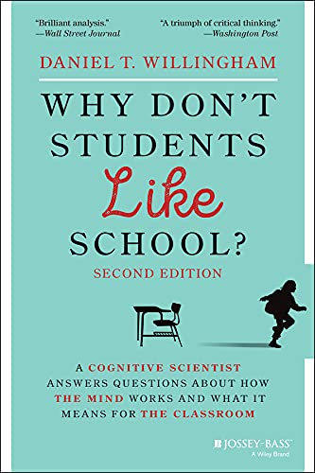
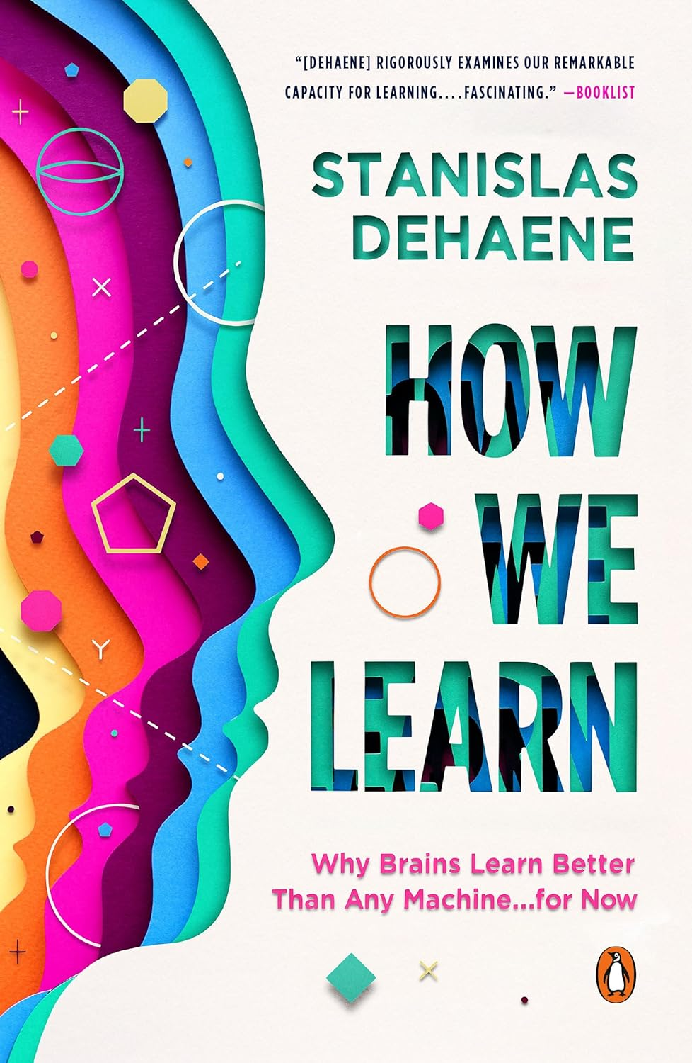
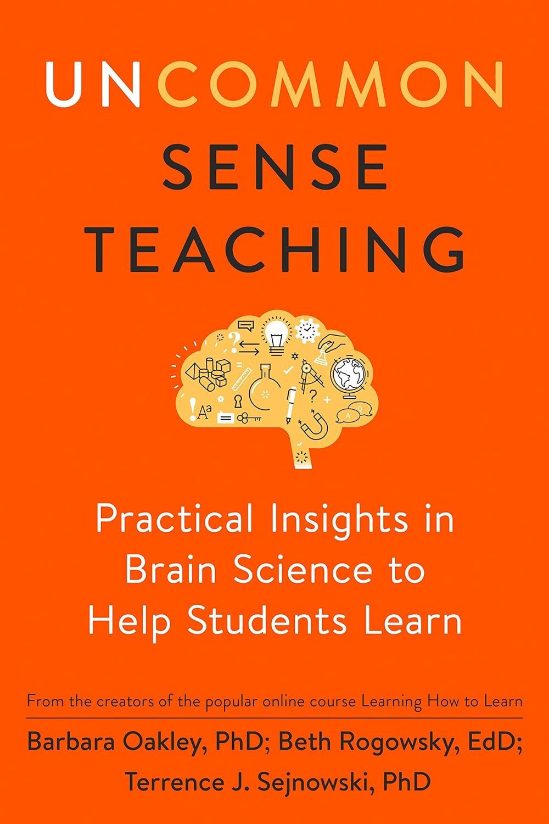

Slide 8
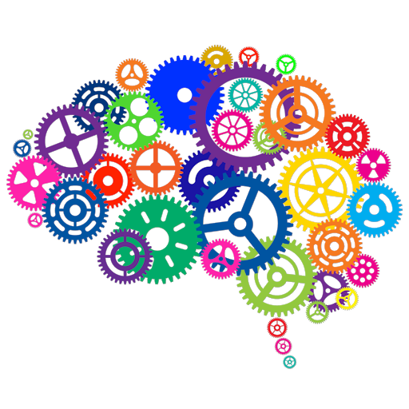
Ask questions! This helps everyone.
Add to the dialogue! This is how we learn.
Notes:
I like this image of the cogs within the brain. We know from cognitive science and psychology that human beings learn through dialogue. That knowledge and information are socially constructed.
I want you to be involved in this session this afternoon. I want you to ask questions and I want you to offer your thoughts and opinions and experiences on what we talk about....this helps everyone.

Slide 9
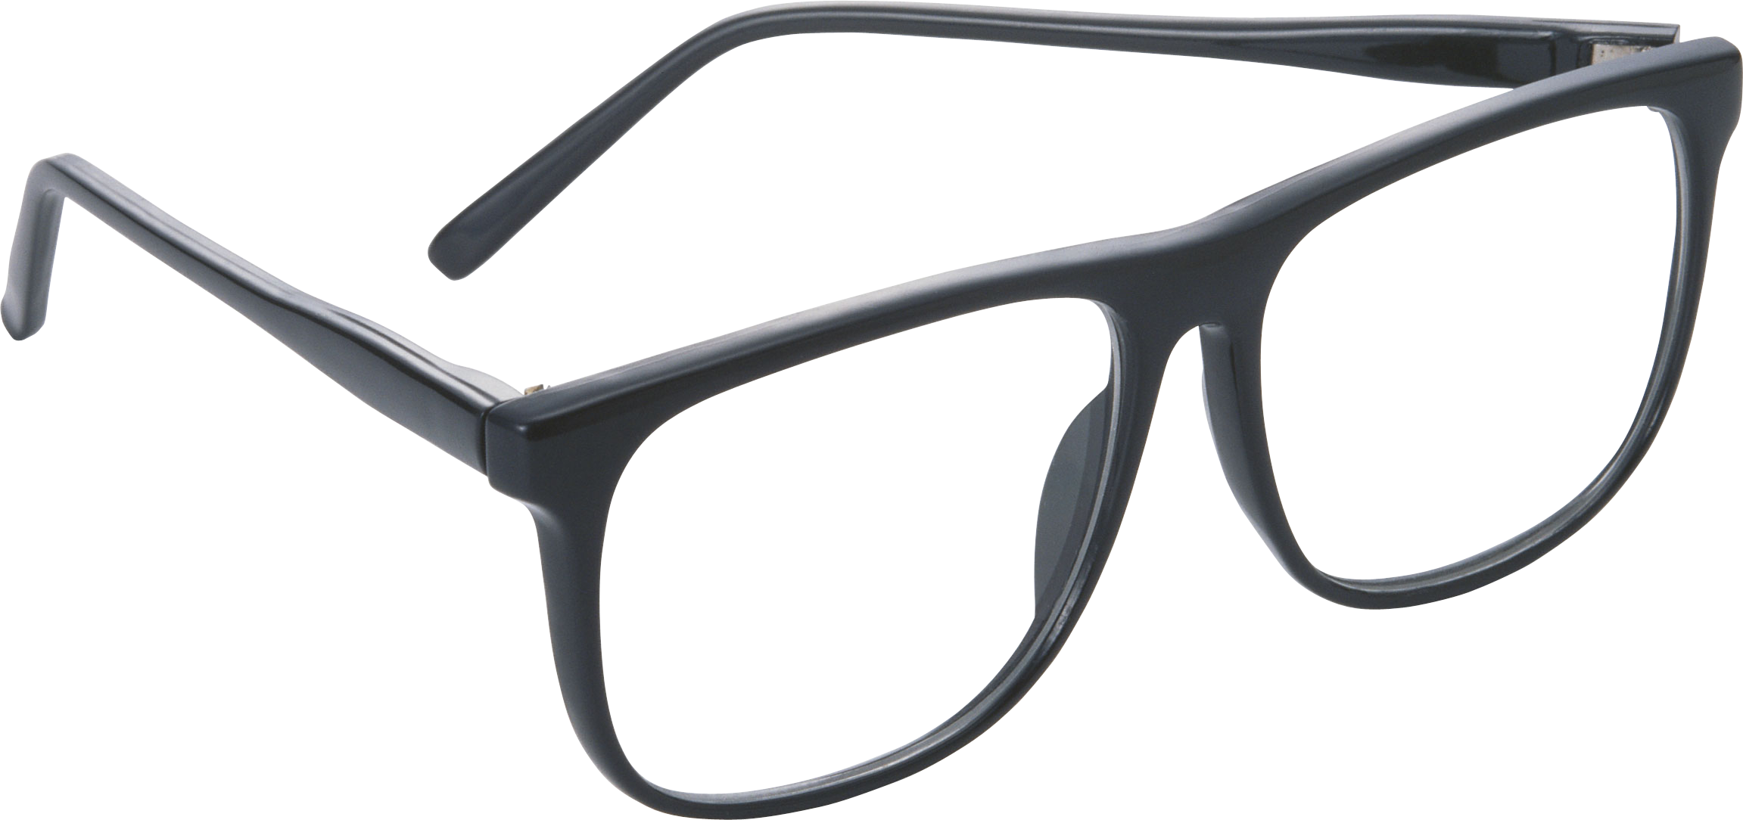
“Without an understanding of human cognitive architecture, instruction is blind.”
John Sweller (2017)
Notes:
I’ve heard various takes on this idea, including the quote: those who know better, do better. Now, in my opinion there’s no questioning your commitment or your love of students. You ARE indeed professional educators. But like most areas in life and learning, we can improve and grow a deeper knowledge of our field.
I want to draw from the work of Kirschner and Hendrick in their excellent book “How Learning Happens”. The first chapter provides insight into the difference between experts and novices.
Novices are not just little experts. No. Experts see things differently. They have quantitatively more knowledge, but equally important they have qualitatively better knowledge.
What you know determines what you see. My goal today is to simply add a bit to what you know so that you may see anew some ways to tackle reading at your schools.
Piaget is quoted as saying: “What we see changes what we know. What we know changes what we see.”

Slide 10
“Checklists of desired practices are poor predictors of teaching effectiveness.
A reflective practitioner is better!”
Paul Howard-Jones
“Evidence-based practices
sometimes do not travel well”
Notes:
Today we are going to talk about some methods in helping students be engaged in the learning process....and more than that, we’re going to talk about some things we need to consider in order to get the brain to think and learn and change and develop. Our goal is to leave here today with some ideas about what we can do in our classrooms on Monday.
But, as you have repeatedly already discovered in your career, sometimes these things don’t work, or they don’t work with this year’s class but they worked in last year’s class.
While it’s good to have a menu or repertoire of teaching ideas and go-to approaches, these so-called checklists and interventions you may pick up here and there are actually not the best predictor of how well you will do as a teacher in your classroom.
You can go to 50 workshops during this year and you’ll find a hundred great ideas. But they may or may not work.

Slide 11
“It would be wonderful if scientists had identified categories of students along with varieties of instruction best suited for each category,
but after a great deal of effort, they have not found such types, and I, like many others, suspect they don’t exist.
I would advise teachers to treat students differently on the basis of the teacher’s experience [knowledge] with each student and to remain alert for what works. When differentiating among students, craft knowledge trumps science.”
Daniel T. Willingham, 2021, p.185
Notes:
Categories of students, like, students with LD or ADHD or reading or math problems, etc....and here is the perfect instruction that matches their need....not gonna happen.
WHY?

Slide 12
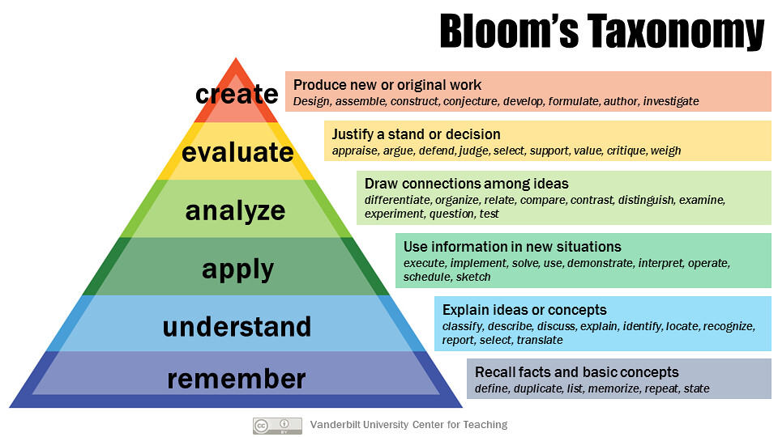

Notes:
I’m going to start this presentation here; Bloom’s Taxonomy. Sort of a weird place to start for a talk about Small Teaching methods that enhances memory and attention and engagement. But I think it’s important to begin here.
Some teachers misunderstand Bloom’s Taxonomy and they see it as a teaching method. It’s not a teaching method. It’s not meant to be applied like a teaching method.
Epistemology is not pedagogy. This is important to keep in mind.

Slide 13
Comprehension
Knowledge
Notes:
I’m going to start this presentation here; Bloom’s Taxonomy. Sort of a weird place to start for a talk about Small Teaching methods that enhances memory and attention and engagement. But I think it’s important to begin here.
Some teachers misunderstand Bloom’s Taxonomy and they see it as a teaching method. It’s not a teaching method. It’s not meant to be applied like a teaching method.
Epistemology is not pedagogy. This is important to keep in mind.
Okay, let me address a couple of warnings here for you. It’s important that you consider all sides of the debate on Bloom’s taxonomy.
I will offer only 3 considerations for you:
1. Learning is not hierarchical as the pyramid suggests, nor is it purely linear either (first, then) as some have come to believe/understand stage development to be this way. It’s blurry...it’s out of order....it’s overlapping and contingent... Knowledge or remembering are NOT any less important than another but the pyramid implies that one is more important or valued than the other. Not true. It’s not how learning works. One is not necessarily more complex than the other either...but may be.
The problem is that learning theorists try to simplify and illustrate how learning occurs and then the illustration becomes the method. Epistemology is not pedagogy.
Thinking and learning and processing is not discreet. You don’t do one and then move on to the other or pick and choose and isolate one over the other. It doesn’t work that way. Your brain will use many, often simultaneously. Likewise, following on the heels of these not being hierarchical, you should think that one progresses to the other...first I know stuff and then I can evaluate it. It may happen that way for some things, but in the opposite direction for other things. Sometimes we create first, evaluate how well that worked and try to understand what went wrong and apply new learning.
Think ‘balanced’....these are valuable and important cognitive skills and they are all worthy of attention.

Slide 14
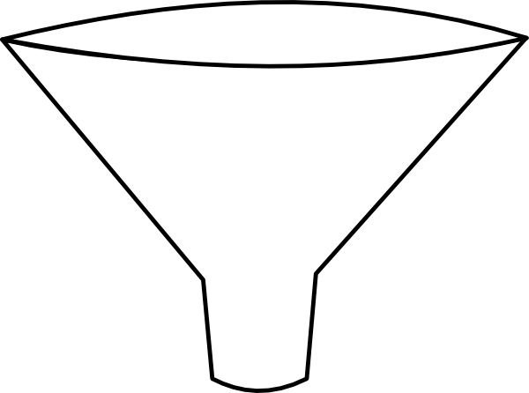
Simplified illustration for memory
Short-term memory
Input
Received
Apparently
unlimited
Long-term
memory
WORKING
MEMORY
ATTENTION
..........Ignore/forget/decay..........
Notes:
Working memory is located somewhere across the brain (multiple regions simultaneously) that acts as a mental workspace that holds and manipulates information for learning and complex reasoning. It holds this information for a brief period of time and can only hold a limited number of items at any one time. This limited capacity has caused some to liken it to a bottleneck within the human brain.
We are not here to talk about working memory today, although it is of critical importance to learning and to memory.

Slide 15
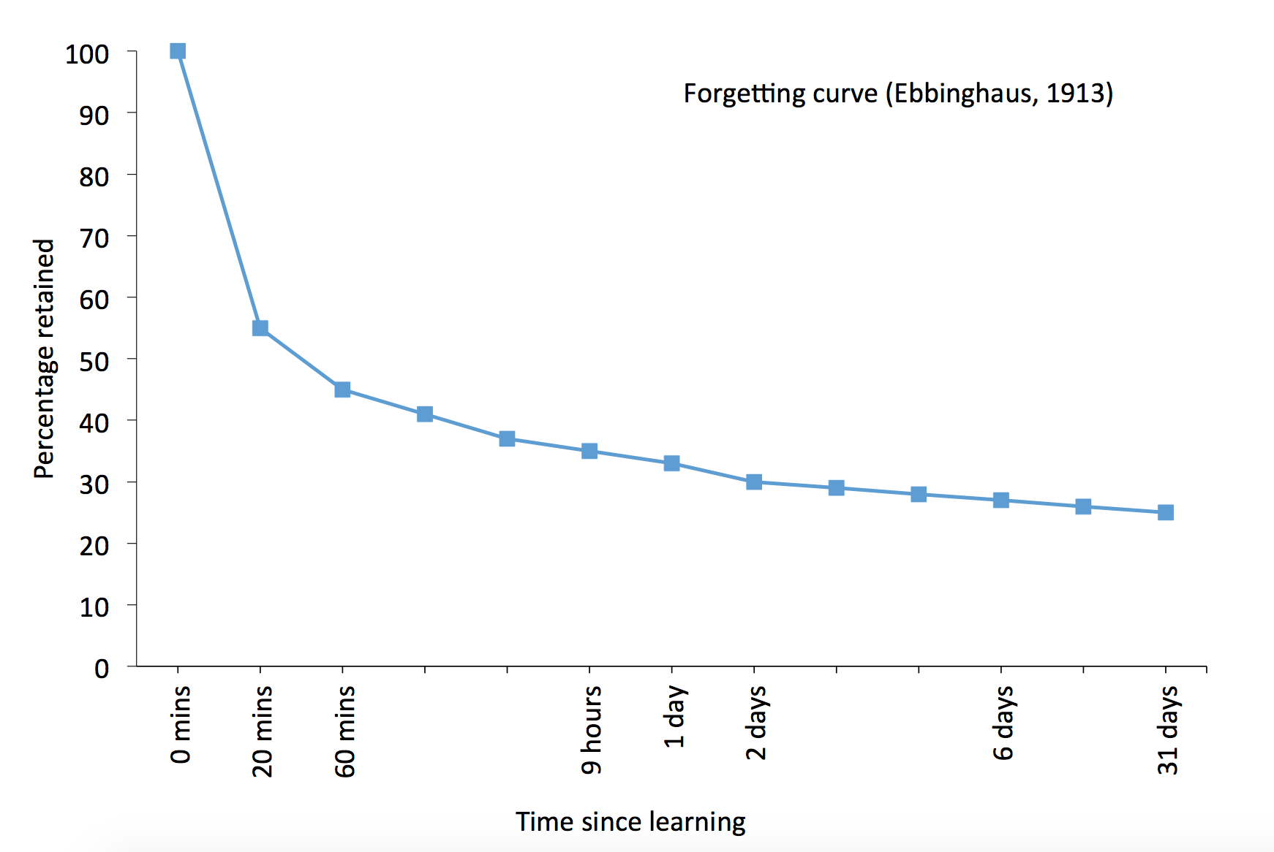
Forgetting Curve (Ebbinghaus)

Slide 16
Forgetting Curve (Ebbinghaus)
What we do in the
initial stages of exposure
assists with intake......
BUT a little forgetting is a good thing and what you do AFTER these initial stages is just as important to long-term learning

Slide 17
Forgetting Curve (Ebbinghaus)
Initial learning Interrupt forgetting
- - - - - -
- - - - - - -
- - - - - - - - -
- - - - - - - - - - - -

Slide 18
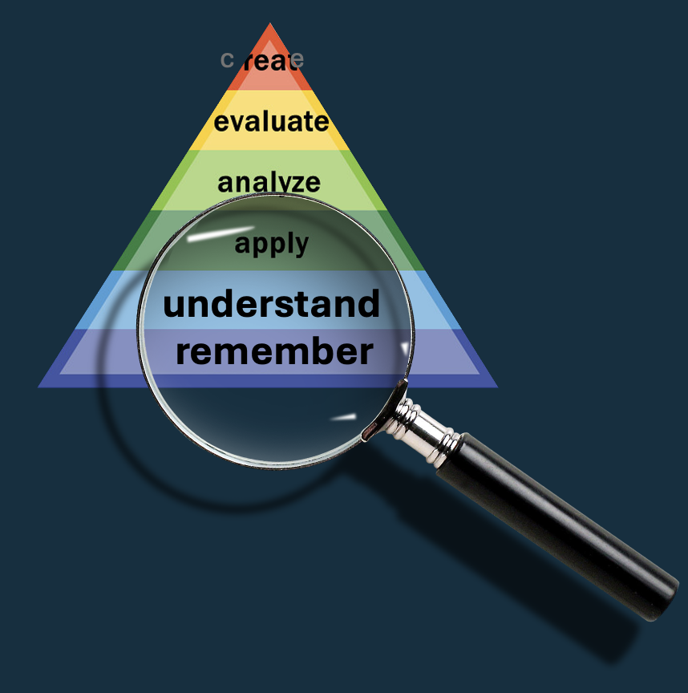
Remembering
Predicting
Priming
Retrieving

Slide 19
Remembering
Predicting
Priming
Retrieving
Notes:
I think it would be a good bet to say that everyone in this room practices this in one form or another multiple times a week. Here I want to give you some empirical evidence to back up this practice and ask you to continue to use this mighty and powerful ’small teaching’ approach.
Predicting takes many forms and can be done multiple times a class. Asking students, ”What do you think will happen next?” Or doing a pretest on the material....or to complete a KWL chart...what they currently know, drawn from their prior knowledge, what do they want to learn or need to learn and then what they have learned.
Predicting is a way that teachers can awaken a student’s prior knowledge for the purpose of calibrating what they know or do not know. It also sets students up for making connections.

Slide 20
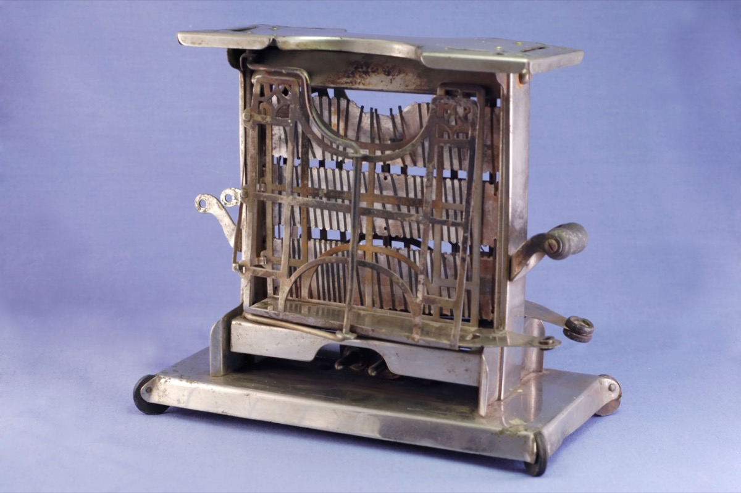
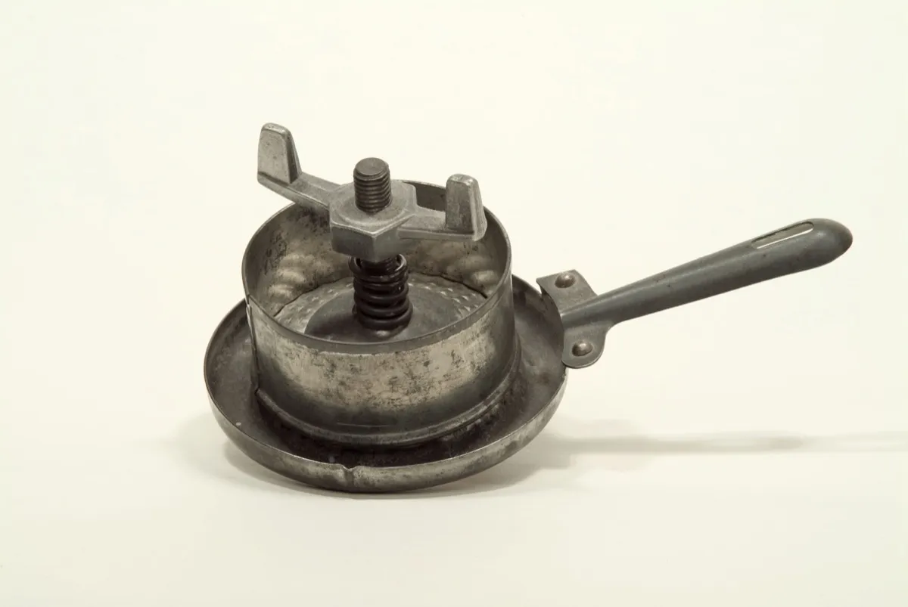
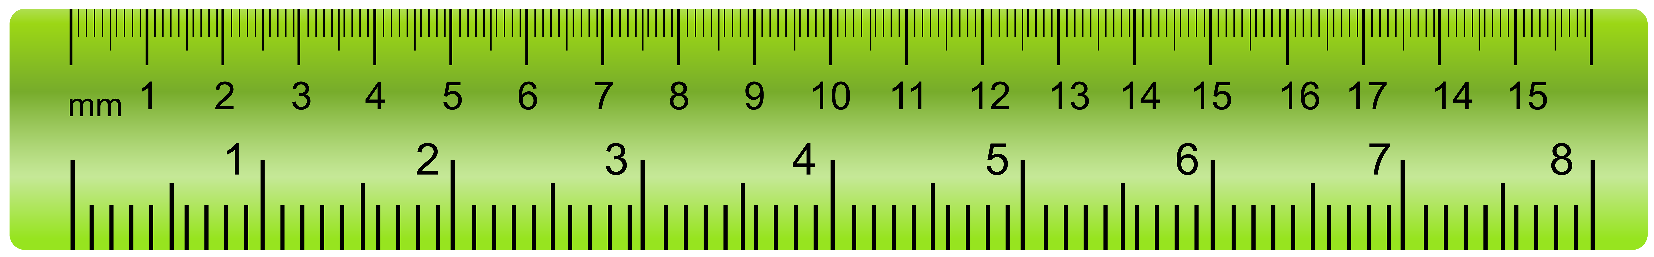

Remembering
Predicting
Priming
Retrieving
Notes:
I’m going to ask you to guess or predict what you think these three items are.
Toaster
Hamburger press
Blueberry Rake

Slide 21
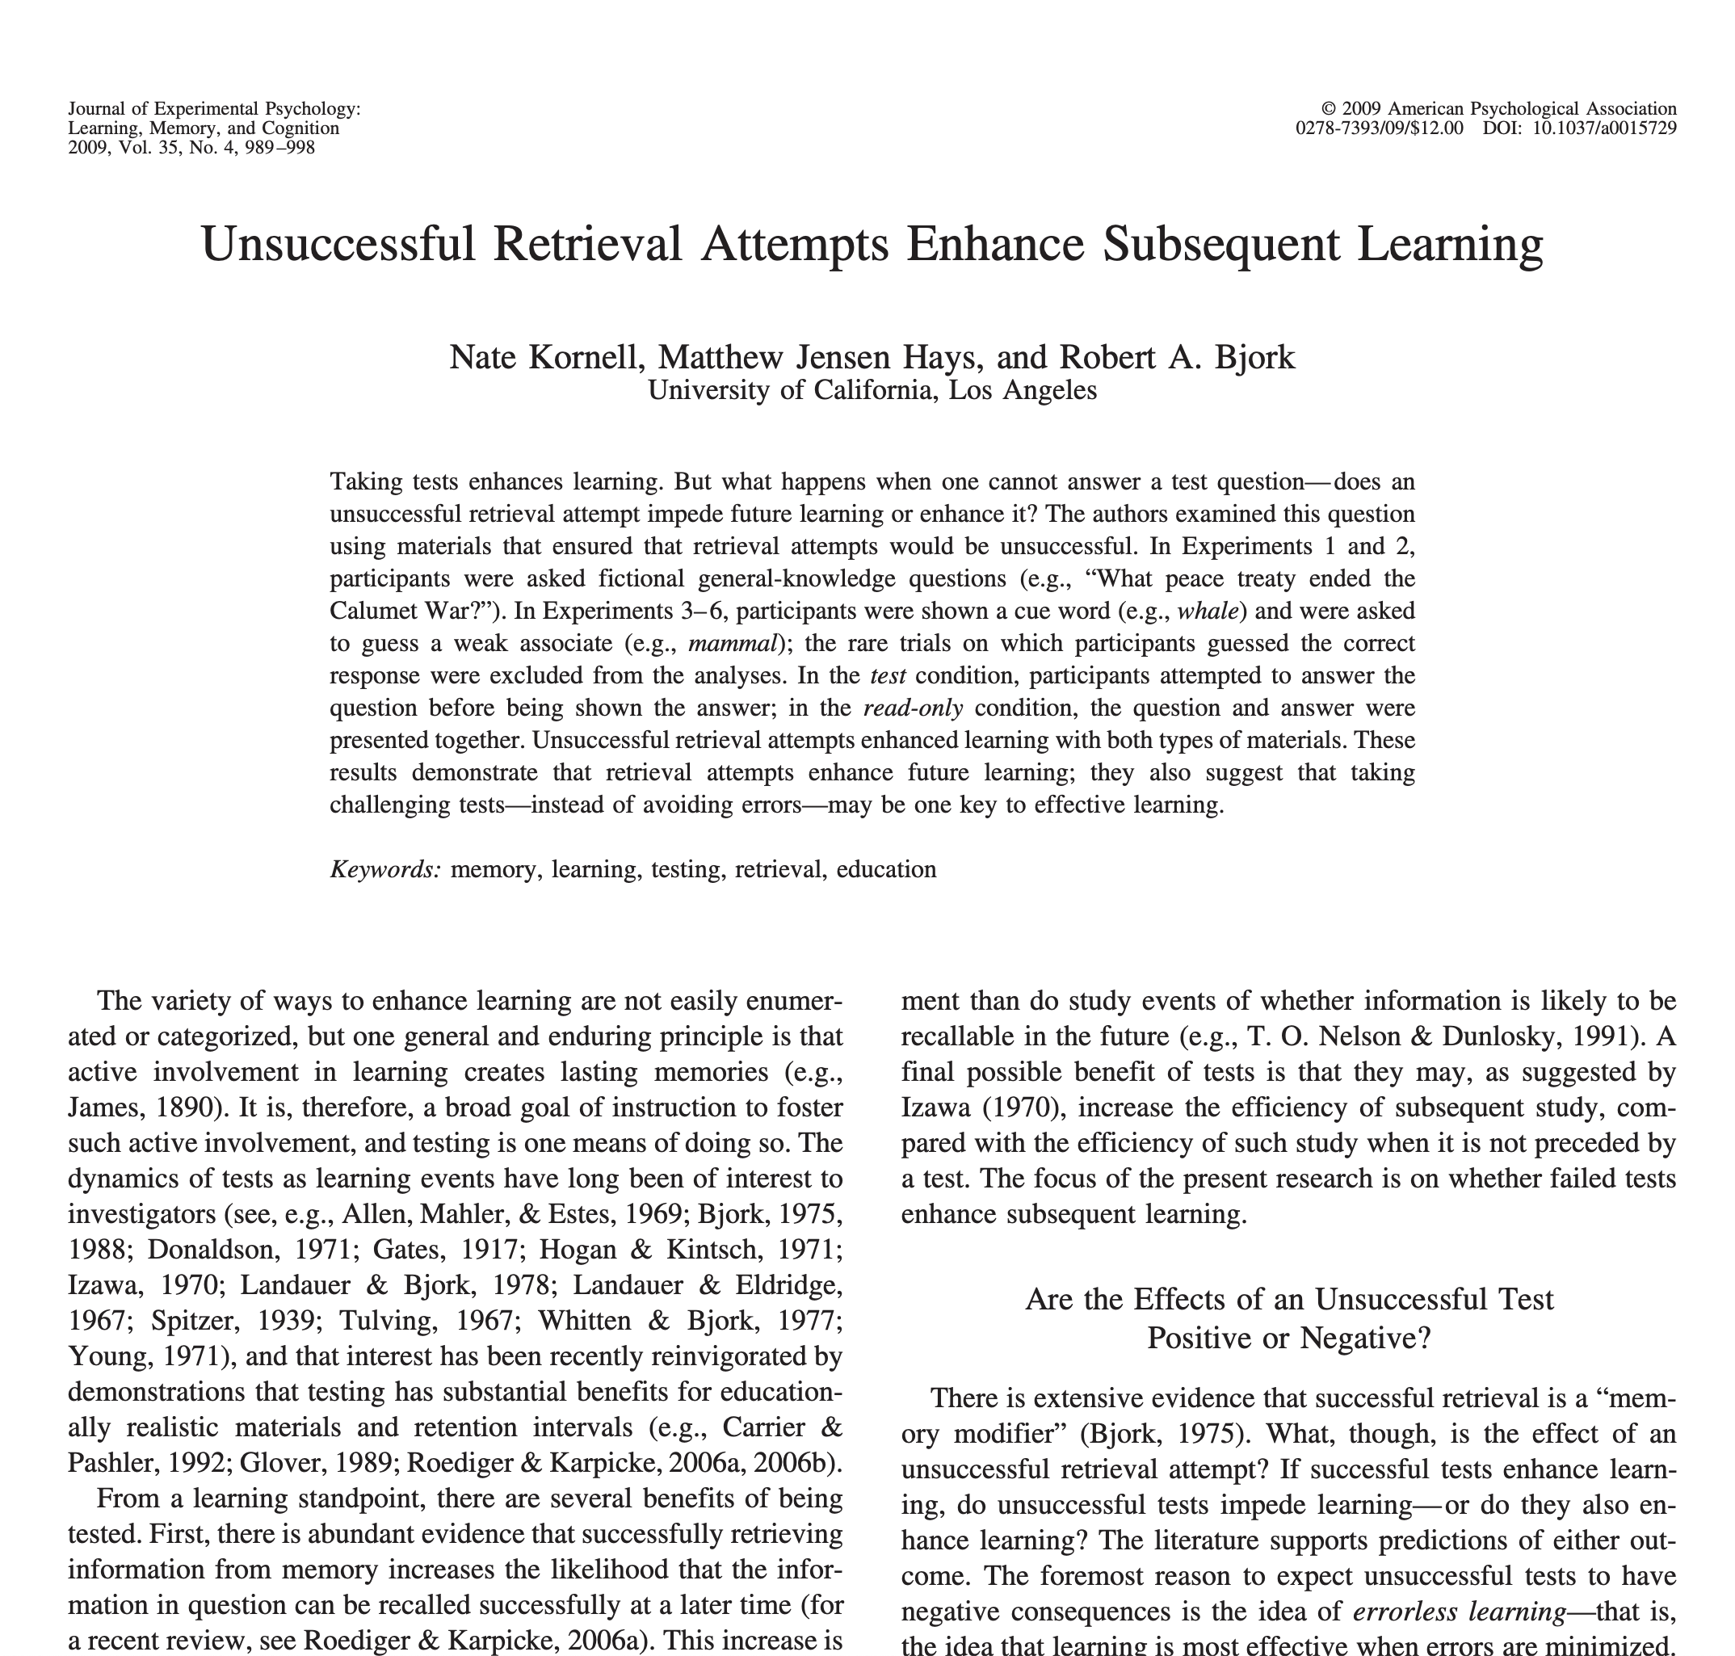
Remembering
Study/memorize a series of loosely connected word pairs (60) and then attempt to recall them later (38hrs later)
STUDY word pairs vs. PREDICT word
13 seconds 5 seconds
(5% accuracy)
Pond – Frog Pond - ?
Mouse – hole Mouse - ?
Whale – Mammal Whale - ?
Train – Caboose Train - ?
Recalled 55% Recalled 67%
Predicting
Priming
Retrieving
Notes:
In a brilliant series of experiments researchers at UCLA asked a group of students to study 60 pairs of words and later asked them to try to recall as many pairs as they could.
Here’s what they did:
Half of the students were given the 60 pairs of loosely associated words....you see some of them here: Pond-Frog, Mouse-hole, and so on. They were given 13 seconds to study each pair.
The second group of students were given the first word of the pair only and asked to predict what the second word would be: Pond? Mouse? and so on. Here’s an interesting feature of this study.
What do you think the predicters success rate was? 5% They were only 5% accurate in guessing the second word. After their guess they were given 5 seconds to study the word, so 8 seconds less than the first group.
Then 38 hours later they were asked to log on to their computers and recall as many pairs as they could once prompted by the first word.
Group A recalled 55% of the terms correctly
Group B recalled 67% of the terms correctly
The conclusion the researchers came to after conducting a series of related studies is that having students make predictions...even though they are incorrect....still assists recall.
Why? Why do you think recall is enhanced through prediction?

Slide 22
Remembering
Study/memorize a series of loosely connected word pairs (60) and then attempt to recall them later (38hrs later)
STUDY word pairs vs. PREDICT word
13 seconds 5 seconds
(5% accuracy)
Pond – Frog Pond - ?
Mouse – hole Mouse - ?
Whale – Mammal Whale - ?
Train – Caboose Train - ?
Recalled 55% Recalled 67%
“...making predictions activates your prior
knowledge about a subject, warming up your
brain and preparing it to learn new information
in the subject area....Making predictions also
stirs up emotions that can help motivate and
drive learning.”
(Sanders & Lang, 2023)
Predicting
Priming
Retrieving
Notes:
Making predictions activates a student’s prior knowledge about a subject....OR it can serve to calibrate how much knowledge they have or don’t have....it causes the brain to invest in curiousity a bit....causes a form of wanting to know...it piques it’s interest and there is a small buy-in....students want to know if their prediction is correct....and if it is, there is a small sensation of satisfaction.
However, even incorrect guesses lead to better learning.

Slide 23
Remembering
“...taking a few seconds to predict the answer before learning it, even when the prediction was incorrect, seemed to increase subsequent retention of learned material” (Emphasis in the original, p.22)
Predicting
Priming
Notes:
Taking only a few seconds to get students to make a prediction seemed to increase subsequent retention of learned material.
Now, there are plenty of types of predicting activities.
-Pretests

Slide 24
Remembering
Predicting
“Neuroscientists are increasingly demonstrating that our brains are prediction-making machines, and that our learning stems most fundamentally from the cycle of making predictions and then adjusting our thinking in light of the accuracy of those predictions” (Lang, 2021, p.25).
“Generating a prediction, detecting one’s error, and correcting oneself are the very foundation of effective learning” (Dehaene, 2020, p.209).
Priming
Retrieving
Notes:
Why do you think that the Predicting group did better? What’s going on here?
Researchers think

Slide 25
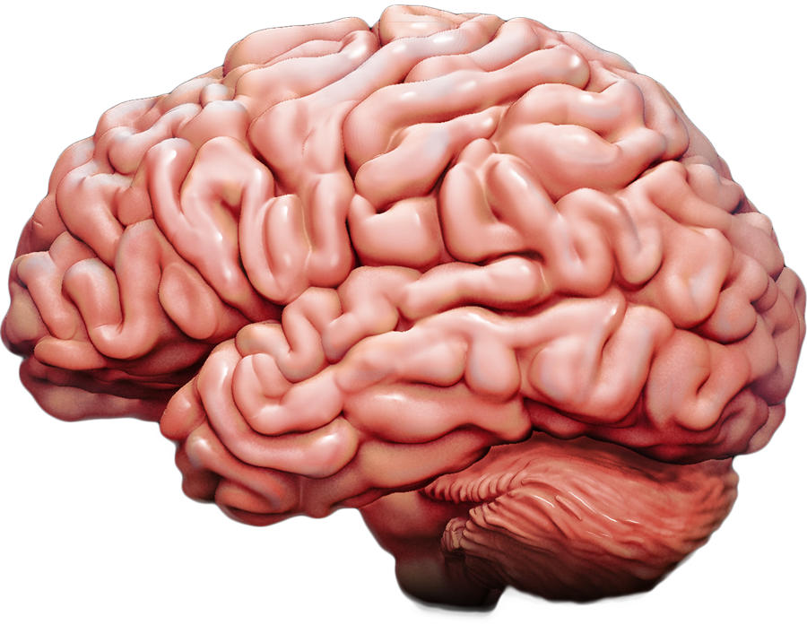
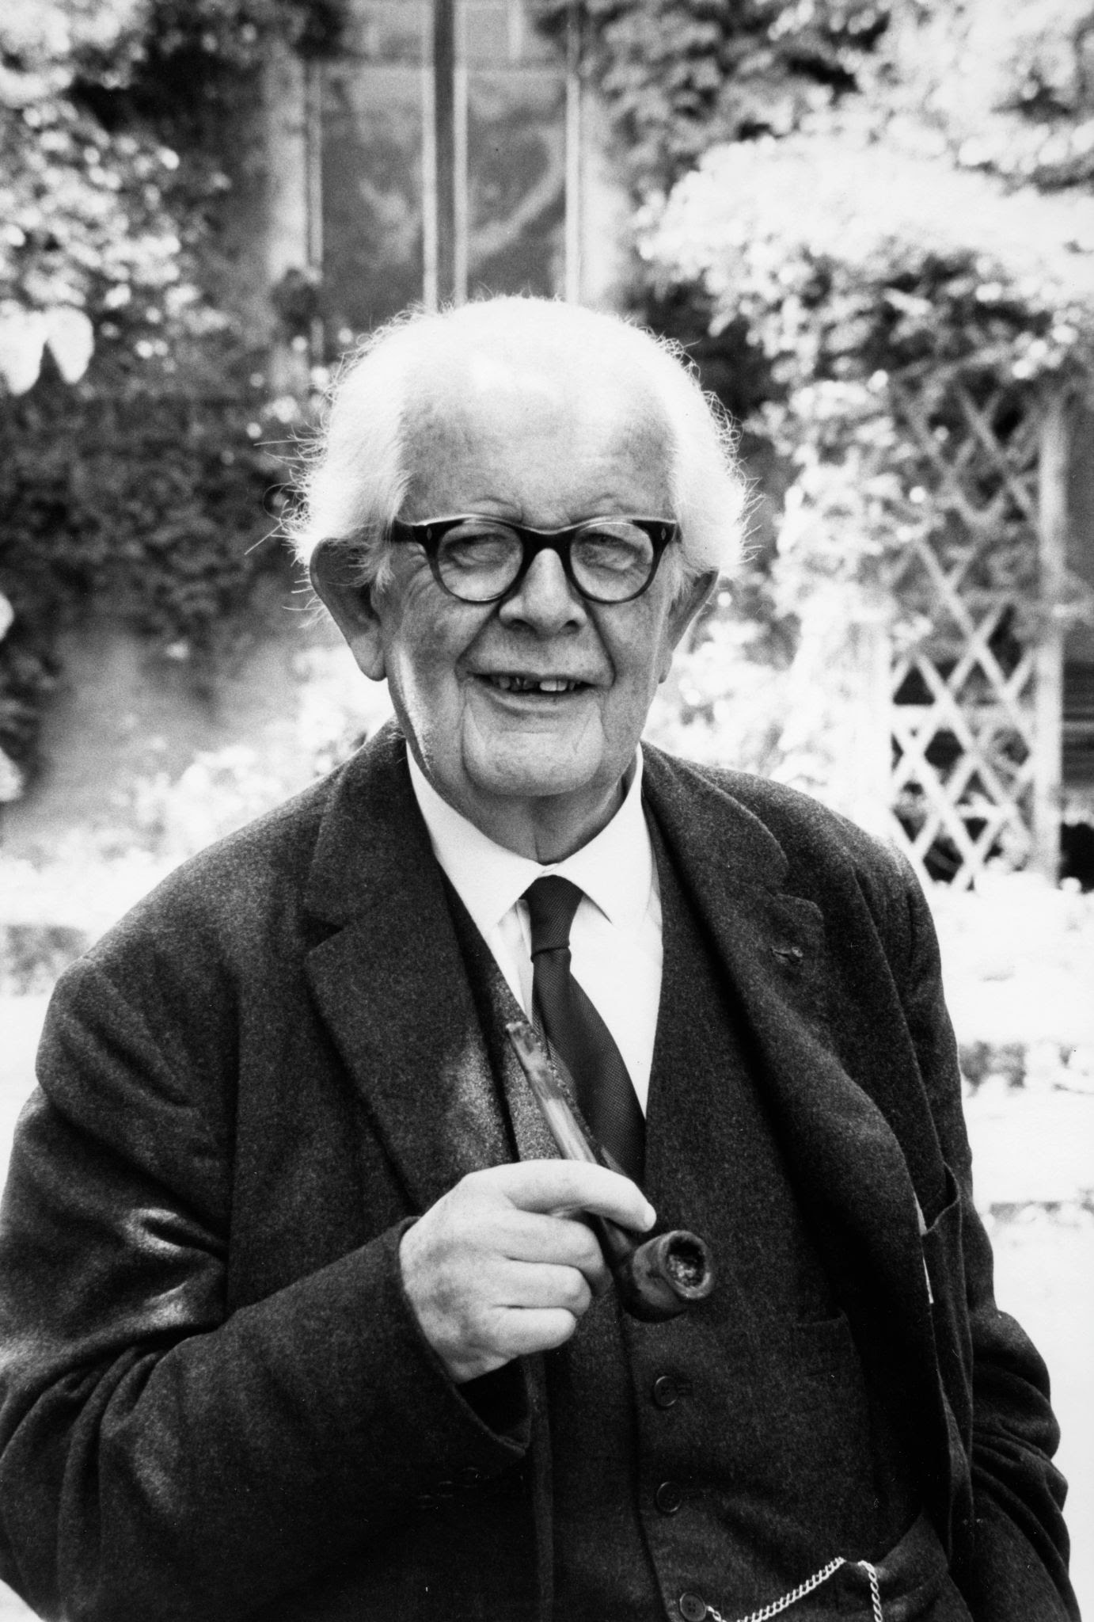
Jean Piaget
Schema or Schemata
Notes:
Held within our brains is our mental model of reality...what we know and believe. Our world view.
It is sculpted, acquired, reshaped, learned, unlearned, created, changed and challenged.....every day. It also serves as our lens for viewing reality. Our schema or schemata.
He said that it is one way that we develop cognitively. When we are confronted with something we don’t know or we are confused about, or does not make sense, we experience a type of mental frustration or disequilibrium
Our brains don’t like this so it works to make sense of ambiguity or disequilibrium...it either changes what it believes or uses the new information to confirm what it believes. We are constantly about the business of refining and changing and developing our mental models, our schema.

Slide 26

Schema
Notes:
Now I realize that all metaphors break down....and they don’t fully represent a construct. And that is true with MY mental image of schema.
I see Schema like a sandcastle. A creation of putting clumps of sand on my schema and chiseling it away. My entire sand castle consists of what I think, what I know, what I believe. Sometimes I learn something new that fits within my current belief system and knowledge system and I ASSIMILATE it into my schema. I just add on another clump of sand....I’m still building. Other times new information comes in that challenges my view of things....and it does not fit within my current belief system or knowledge. I can reject it (even if its true) and not assimilate it. Or I can come to the place where I have to change my schema....maybe reshape it, maybe carve something off, to change to this new information. That’s called ACCOMMODATION....I accommodate this new learning on my schema.
Now the sandcastle illustration, metaphor, is not a perfect representation of Schema.....You see, we USE our schema to judge everything. We USE our existing prior knowledge to evaluate something, to judge it, to learn. It is much easier to learn something if we first compare it to our prior knowledge...our schema....because it’s easier to link it to our known ideas....
One thing we believe to be true is this. EVERYTHING....EVERYTHING you know...everything you understand, believe, think about, perceive, comprehend, dream...Your mental framework...is created, constructed, socially and incrementally as you hear, listen, engage, respond. This is also now called your Prior Knowledge....you use this to judge everything you’re now faced with. It is a complex process that involves multitudes of pieces that you need to construct. You may see a new object called a Blurblic. What? I tell you what it is and use your prior knowledge to describe it. It flies, it’s living, it breathes, it is big like a plane, but its purple and breathes bubbles...etc. etc. This fictional figure takes shape in your imagination as you compare it to what you already know....this is brought to bear on your new object.
You are a product of millions of interactions with data....data being everything that lies before you.
Jean Piaget (1896-1980) said that this mental framework is our Schema, or a developed schmata. And this mental mind is used to learn everything new.
And he distinguished two very important processes as our Schema develop throughout our entire lives: Assimilation and Accommodation
Accommodation is creating new schema that will fit better with the new environment or adjusting old schema. Accommodation could also be interpreted as putting restrictions on a current schema, and usually comes about when assimilation has failed. Assimilation is when people use a current schema to understand the world around them. Piaget thought that schemata are applied to everyday life and therefore people accommodate and assimilate information naturally.^{[31]} For example, if this chicken has red feathers, Bob can form a new schemata that says "chickens with red feathers can lay eggs". This schemata, in the future, will either be changed or removed entirely.
Assimilation is the reuse of schemata to fit the new information. For example, when a person sees an unfamiliar dog, they will probably just integrate it into their dog schema. However, if the dog behaves strangely, and in ways that doesn't seem dog-like, there will be an accommodation as a new schema is formed for that particular dog. With accommodation and assimilation comes the idea of equilibrium. Piaget describes equilibrium as a state of cognition that is balanced when schema are capable of explaining what it sees and perceives. When information is new and cannot fit into a previous existing schema, disequilibrium can happen. When disequilibrium happens, it means the person is frustrated and will try to restore the coherence of his or her cognitive structures through accommodation. If the new information is taken then assimilation of the new information will proceed until they find that they must make a new adjustment to it later down the road, but for now the person remains at equilibrium again. The process of equilibration is when people move from the equilibrium phase to the disequilibrium phase and back into equilibrium.^{[32]}

Slide 27
Remembering
Predicting
Priming
Retrieving

Slide 28
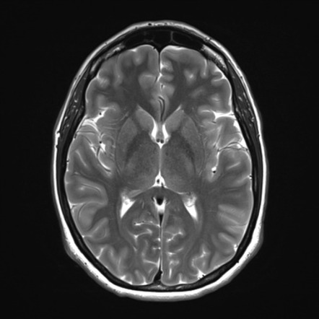







Neuroscience
Pre-Activate
Strategies to
Guide
Learning
Psychology
Education
This brain is trying to decide how best to respond to a set of stimuli
This brain has already decided how to respond to a set of stimuli
PEN Principle #12
Cognitive Load
https://slrc.au.org/
Notes:
PEN Principle 12: Pre-Activate Strategies to Guide Learning
This PEN Principle is called Priming....the goal here is to prime students to perform the types of activities that you want them to learn to do by using similar strategies before you do your lesson.
Determine how you want students to interpret and interact with your lesson (maybe you want them to compare and contrast something, or perhaps you want them to use metaphors in their writing, or supporting details ,or to look for relationships among chemicals in chemistry).
Whatever skill or behaviour you want them to practice, do a warm up activity beforehand that uses the same type of expected behaviour. This guides their thinking and primes them to complete an activity more successfully.
It’ doesn’t have to be a long activity. It’s a warm up activity.
Research in this area is interesting. Students who played a memorization game prior to a lesson demonstrated better memorization of the lesson facts.
Students who played a Compare & Contrast game prior to the lesson demonstrated better critical evaluation of the lesson later in the class.
Students who played an organizing game, where they had to sort objects by size, then did a better job of doing the same types of things in their lesson.
They were primed to think and behave a certain way. These warm up activities actually prime the brain to respond to new content.
OR guiding students thinking with some sort of advance organizer can help them organize their thinking and learning.

Slide 29
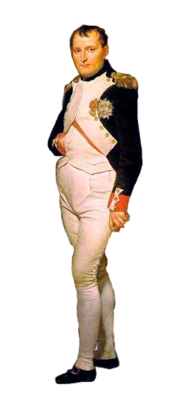


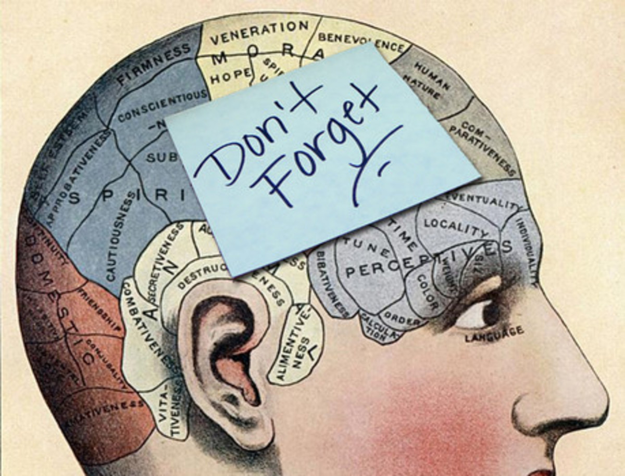
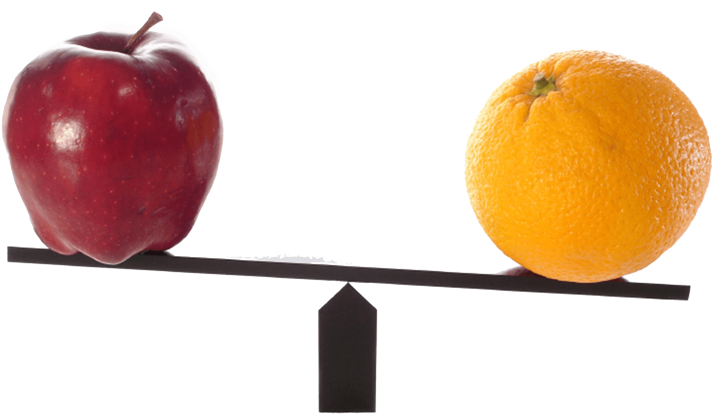
Rote memorization game
Compare and contrast game
Notes:
In an experiment involving how pre-activating strategies can enhance comprehension in a primed way researchers compared to groups of students who received the same history lesson.
One group of students were given a rote memorization game before the history lesson
Another group of students were given a compare and contrast game before the history lesson.
Those who were given the memorization game demonstrated enhanced memory for specific lesson content and facts
Those who were given the compare and contrast game before the lesson demonstrated enhanced critical evaluation of larger lesson themes.
What you do before the lesson influences how students think about the lesson, analyze the lesson and what they take away from the lesson.

Slide 30
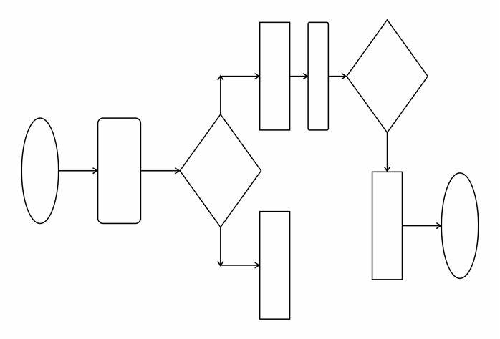
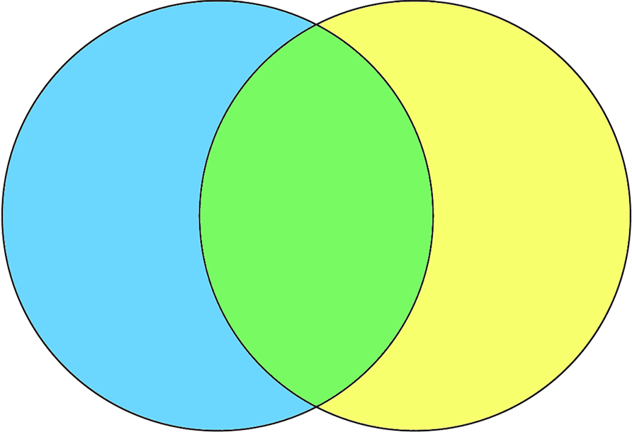
Comparative / inferential
Cause and effect / procedural
Notes:
Similarly in another experiment, students who were asked to do an activity before class using a venn diagram later interpreted lesson content in a more comparative, inferential manner,
Whereas students who did an activity using a step-wise flow chart later interpreted the same content in more cause and effect, procedural manner.
So, determine how you want students to interact with the material. Design a warm up activity that helps prime them to this way you want them to interact.

Slide 31
Remembering
Predicting
Priming
Retrieving

Slide 32
Remembering
The best way to remember something
Predicting
Priming
is to try and remember it.
Retrieving
Notes:
Retrieving

Slide 33
Neuroscience
Active Recall
Trumps Passive
Review
Active Recall
Passive Review
Psychology
Education
PEN Principle #9
Notes:
We’re going to look at two seemingly unrelated things today. This one, PEN Principle #9 Active Recall Trumps Passive Review and Barak Rosenshine’s 10 Principles of Instruction. We’ll get to those in a few moments.
What is passive review: the act of simply recognizing previously learned material when we re-encounter it. Strategies such as rereading the passage, or reviewing notes, or listening to a recording of the lecture, etc. etc......we re-encounter the material, we recognize it....and we think, “Ah, yeah, I get it...I understand it.” And you probably do.....but this doesn’t mean you remember it and that your long term memory has been changed.
What is Active recall: Active recall is when we retrieve, not just recognize, but retrieve previously learned material. Recall is linked to deep memory formation.
Active Recall strategies are effortful...hard...require more effort. Strategies such as flash cards or asking students to tell us again what they remember. For this reason quizzing...either low stakes or no stakes are very effective.

Slide 34
Passive Review
Active Recall
Rereading a passage, even several times
until you are FAMILIAR with it
Reviewing your notes
Listening to a recording of the lesson
Retrieving previously learned material without first reencountering it...or reviewing it.
Trying to pull something out of our memories that we are not currently thinking about
“Yes, I understand it, I get it”
Maintenance rehearsal: repeating of
information to try to memorize it or hold it
in your head as long as possible
- Repeating a phone # until you dial it
- Holding facts in your mind until the test
Requires more effort
Effortful Learning
Desirable difficulty
Retrieval practice
Elaborative Rehearsal
Notes:
We’re going to look at two seemingly unrelated things today. This one, PEN Principle #9 Active Recall Trumps Passive Review and Barak Rosenshine’s 10 Principles of Instruction. We’ll get to those in a few moments.
What is passive review: the act of simply recognizing previously learned material when we re-encounter it. Strategies such as rereading the passage, or reviewing notes, or listening to a recording of the lecture, etc. etc......we re-encounter the material, we recognize it....and we think, “Ah, yeah, I get it...I understand it.” And you probably do.....but this doesn’t mean you remember it and that your long term memory has been changed.
What is Active recall: Active recall is when we retrieve, not just recognize, but retrieve previously learned material. Recall is linked to deep memory formation.
Active Recall strategies are effortful...hard...require more effort. Strategies such as flash cards or asking students to tell us again what they remember. For this reason quizzing...either low stakes or no stakes are very effective.

Slide 35
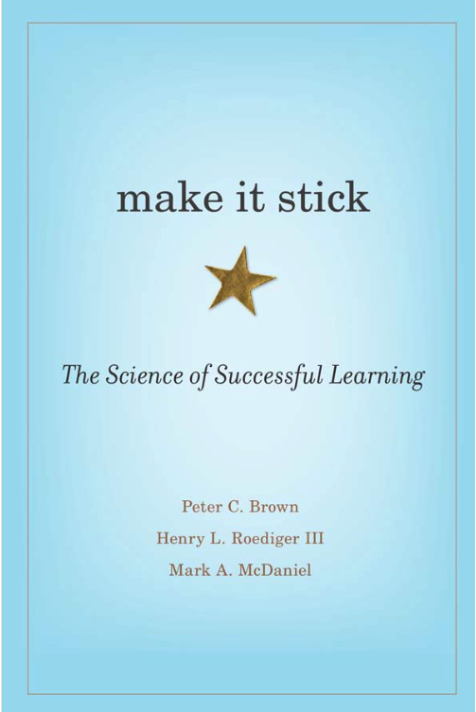
Elaborative Rehearsal
“If you’re just engaging in mechanical repetition, you quickly hit the limit of what you can keep in mind. However, if you practice elaboration, there’s no known limit to how much you can learn. Elaboration is the process of giving new material meaning by expressing it in your own words and connecting it to what you already know. The more you can explain about the way your new learning relates to your prior knowledge, the stronger your grasp of the new learning will be, and the more connections you create that will help you remember it later.” p.5

Slide 36
Elaborative Rehearsal
Strategies include:
Explaining something in your own words
Use metaphor/analogies/graphic images to represent new ideas and information
Use quizzing to promote learning
Reflection: think deeply on what you understand and remember
Calibration
Generation & Prediction
Mnemonic devices
(p.206-210)
Notes:
Elaboration is more complex than maintenance rehearsal and uses stronger encoding strategies that links new information with information you already know

Slide 37
Learning is deeper and more durable when it’s effortful.
Learning that’s easy is like writing in sand, here today and gone tomorrow
“Memory is the residue of thought”

Slide 38
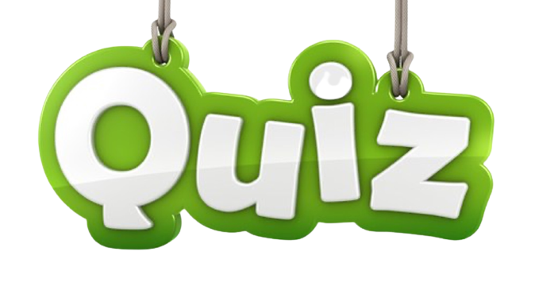
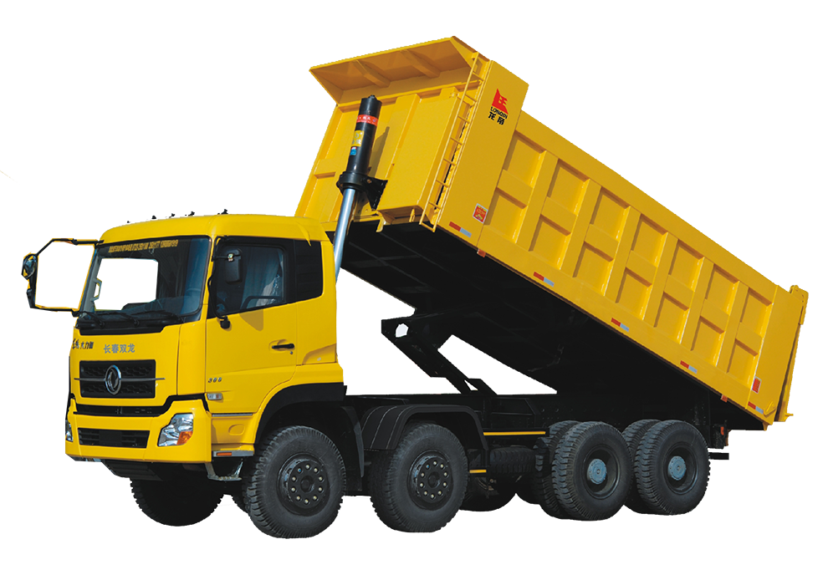
No-stakes / low-stakes quizzes
Paired quizzes
Team quizzes
Group BrBrainain Dump
Topic Dump
2MW individually
Image prompts
Think WIN-WIN
https://www.retrievalpractice.org/
Tests don’t just measure how much we remember,
they improve how much we remember
Notes:
I do lots of things to practice retrieval.
The more you practice retrieving the better you get at it. And don’t we want our students to remember what we taught? Of course we do. It’s good to get them to retrieve as often as possible in order to interrupt forgetting.

Slide 39
Forgetting Curve (Ebbinghaus)
Initial learning Interrupt forgetting
- - - - - -
- - - - - - -
- - - - - - - - -
- - - - - - - - - - - -
Please share some of your ideas
Notes:
You do this all the time....please, anyone share with the whole group an idea you use in your classroom right now.

Slide 40
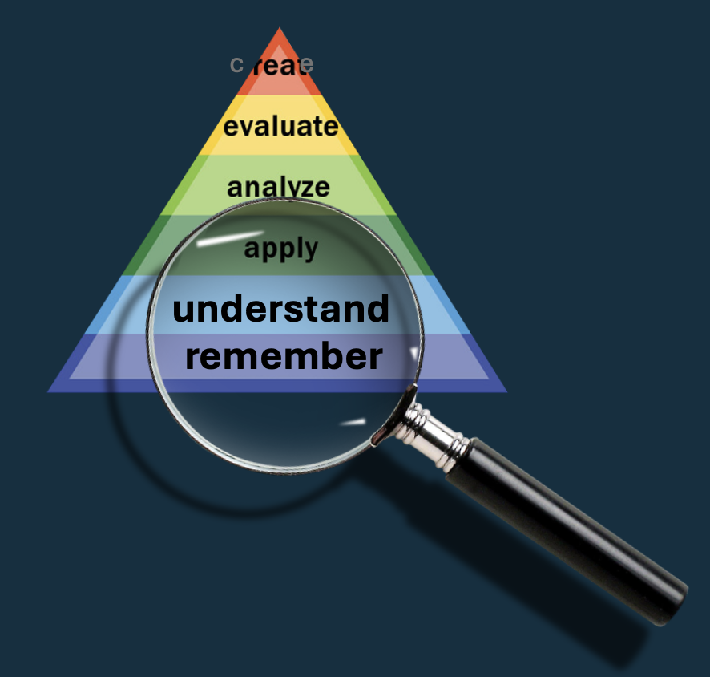
Understanding
Connecting
Explaining

Slide 41
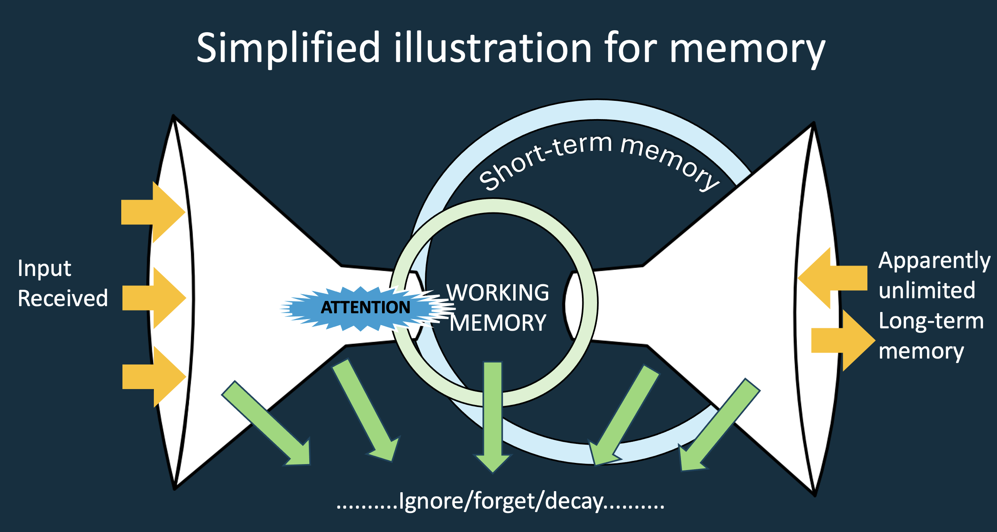
Understanding
Connecting
Prior Knowledge
Explaining
Notes:
I’m going to bring back two images I’ve already used and make this statement that I’m certain you’re already well familiar with: It is impossible to learn new content without engaging prior knowledge.
It is impossible to learn anything new without pulling from your long term memory and referring to your prior knowledge.....impossible.
Unless you deliberately link new information to already-learned-information you are more likely to forget it.
EVERY WORD I’VE SPOKEN THIS AFTERNOON CAN ONLY BE UNDERSTOOD BY YOUR BRAIN REACHING INTO YOUR LEXICON OF WORDS, MEANING, EXPERIENCES AND SO ON AND CONNECTING THEM.
Let me illustrate: I’d like you to respond to this: Blanmp dubba swmant zut lug wal ti verr vee umm pa woo

Slide 42
Think about what’s happening in your brain right now
Notes:
How are you able to SEE that memory in your mind’s eye?
What are you getting the brain to do?
What is a memory anyway?

Slide 43
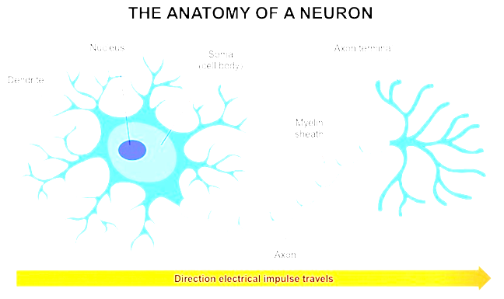

Nucleus
Soma
(Cell Body)
Axon Terminal
Dendrite
Myelin
Sheath
Dendrites
Axon
Direction electrical impulse travels
The surface of the dendrites are covered with thousands of axon buttons. Each cell has 10,000 to 20,000 connections
Notes:
How are you able to SEE that memory in your mind’s eye?
What are you getting the brain to do?
What is a memory anyway?

Slide 44
Notes:
As you hear something, see something, experience something, there is an electrical and chemical reaction. You’ve just been taught a new vocabulary term in Math. Your brain processes information by electrical and chemical reactions. This is an illustrative depiction of that first moment. Your brain produces an electrical and chemical CODE or sequence of that information.... The first time this occurs, and neurons hook up, the connection is a temporary fleeting trace. When you try to remember you ask your brain to recall that code.
Your brain does this remarkably well in many cases. The more you ask it to recall the new interaction, the more the neurons align themselves to accommodate replaying of that electrical and chemical sequence...and they thicken and become more dense and connected.
Every new piece of information you hear and learn is first an electrical and chemical occurance.

Slide 45
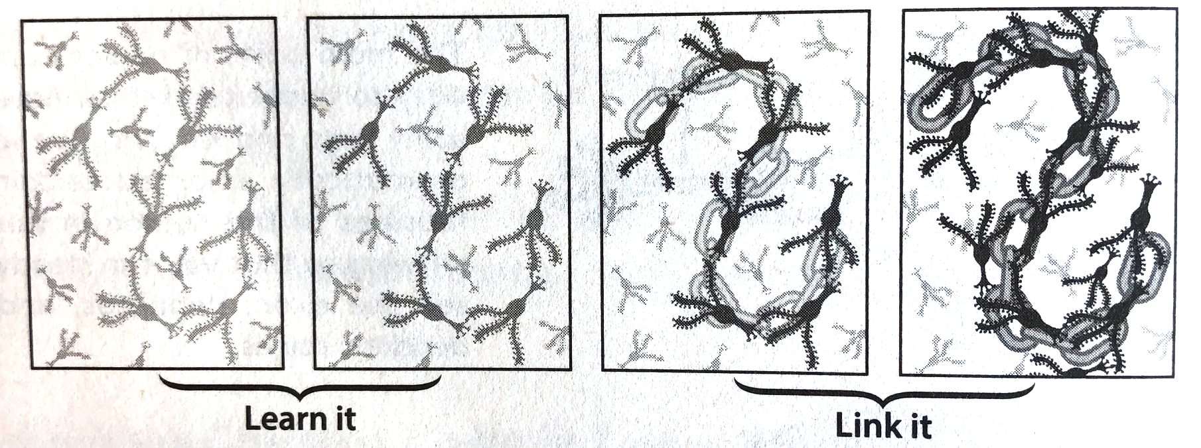
“Students lack comprehension because they lack connections”
Uncommon Sense Teaching (2021, p.4)

Slide 46
“Hence, a simple way to understanding how to build comprehension in our students would be one that consists of helping them forge rich, interconnected networks of knowledge –ones that enable each existing piece of information in our content area to connect with lots of other information, concepts, and ideas.”
(Lang, 2021, p.97)
“We don’t have to make the connections for them; in fact, it is much better if we don’t. We can just throw a concept out there, like a ball, and ask, ‘What does this remind you of that you’ve encountered in your everyday life?’ (McGuire, 2015, p.26)

Slide 47

Connection Notebooks
How does something you learned in class today connect to something you have learned or discussed in another class?
Can you identify a tiktok video, music video, television show or film that illustrates the course concept today?
Connect today’s lesson to a current cultural event you’re hearing about on the news
Construct a concept map illustrating today’s main take-aways

Slide 48
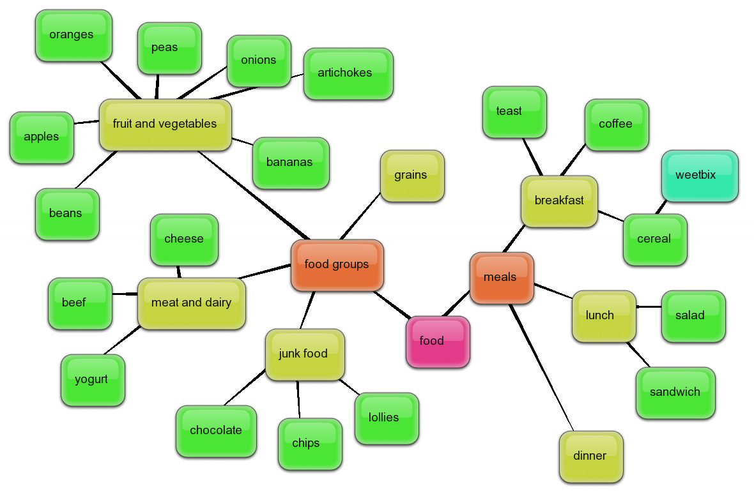
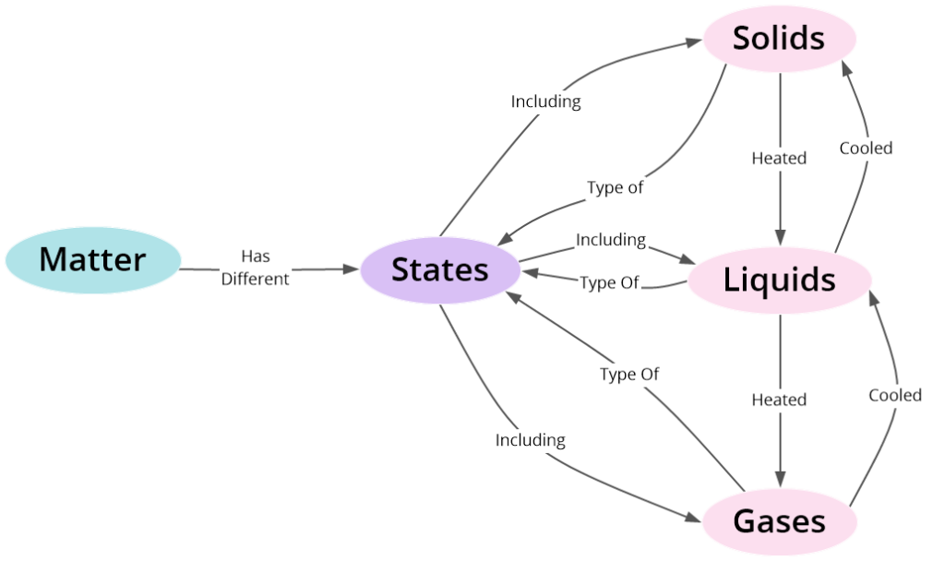
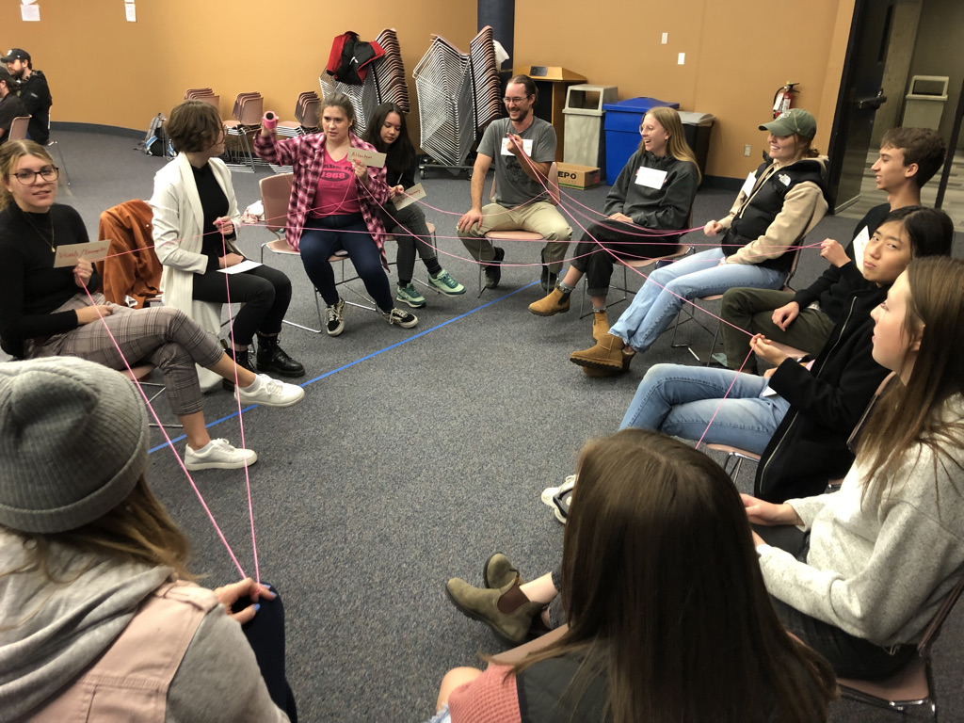
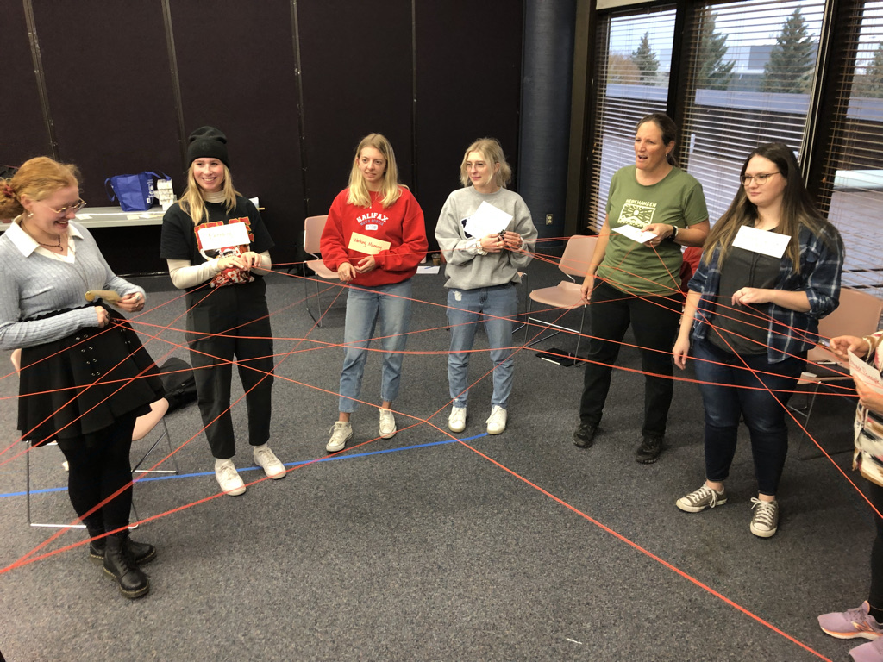
Concept /
Mind Maps
(End of class summary activity)
Identify the
connections
Activity

Slide 49
Understanding
Connecting
Explaining
...Self-Explaining
Talk-Alouds: to self, to a peer, with worked examples
Diagraming / illustrating
Writing

Slide 50
Understanding
“Learners benefit from explaining out loud (to themselves or a
teacher) what they are doing during the completion of a learning
task...and when students are asked to teach something to other
students, or even just asked to prepare to teach to other people,
they learn it more deeply than if they were asked to study the
material for an exam or other assessment” (Lang, 2021, p.137)
Connecting
Explaining
...Self-Explaining

Slide 51
Talk-Alouds: “The gold standard for self-explanation”
Talking/Thinking out loud
+
Preparing to teach it to a peer
=
Greatest
Comprehension and greatest near & far transfer
Talking/Thinking out loud
+
Worked examples
=
Greater
Comprehension
Talking/Thinking out loud
+
Teacher listening/prompts
=
Increased
Comprehension
“...when students study or learn material with the understanding that they have to explain it to someone else, such as a peer or outside audience, it deepens their understanding.”
(Kobayashi, 2019)
Calibrates our current understanding
Surfaces our thinking and mental models
Creates an emotional connection to the material
Requires students to use analogies, examples, demonstrations, etc. to teach the idea to someone else
Notes:
In a series of research studies done by Chi and his colleagues they were able to determine that asking students to talk out loud as they work through problems produce greater learning gains. And even better gains when they are given worked examples (in math, science, ELA, etc) and talk out loud as they work through the examples.
PAGE 138: In one small study of just 10 students a group of researchers divided students on how well they tested on material.....after observing and recording them study (video/microphones). Students were provided a series of workGood students scored an average of 82% on the high school physics material, Poor Students average 46%. The Good Students it turned out talked a lot compared to Poor Students: The 5 good students produced 140 lines of self explanation in completing the worked examples for the
CALIBRATES OUR CURRENT UNDERSTANDING: Hearing ourselves try to explain a concept helps us gain perspective on what we really know
SURFACES OUR THINKING: our understanding, but also our biases, our assumptions and maybe our erroneous beliefs....and this helps us teach our students. Asking a student to surface their schemas is necessary to bring disequilibrium and correction to misunderstanding.
Kobayashi 2019: a meta-analysis of dozens of studies on talk alouds. These activities create an emotional buy in because students DO want to do well and look competent with peers. This is why science fairs are important.
Recent Inquiry Project Conference.
When students have to teach materials to a peer they often resort to using analogies,

Slide 52

3 Minutes

Slide 53
Thank you for your kind attention and participation!
Connect with me if you have any
questions or comments
chris.mattatall@uleth.ca
Dr. Chris Mattatall
GoodTeaching.ca

