Slide 1
Teaching Mathematics to Students with Learning Disabilities
NOTE: This session was delivered by Dr. Mattatall when he was at
Memorial University
Dr. Chris Mattatall
Faculty of Education

Slide 2
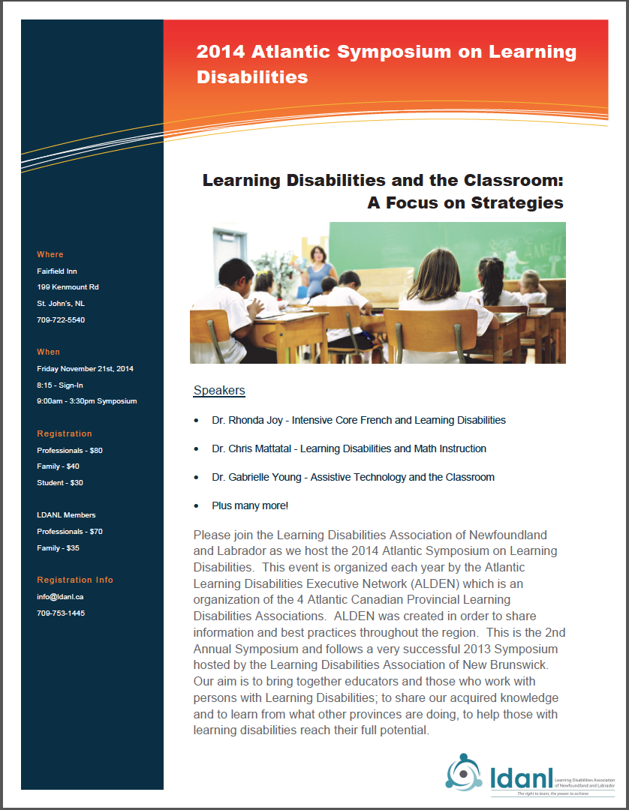
Our Outline and Objectives Today
☑ Understand why math doesn’t add up for some
students with LD
☑ Explore a few effective approaches to teaching
mathematics to students with LD
☑ Briefly view effective assistive and instructional
mathematics technology to help at home and school

Slide 3
ask
questions
at any
time...
this helps
everyone
add to the
conversation
at any time…
this
strengthens
the dialogue

Slide 4
Why math doesn’t add up
for some students with LD

Slide 5
Let’s do a little test ☺
+

Slide 6
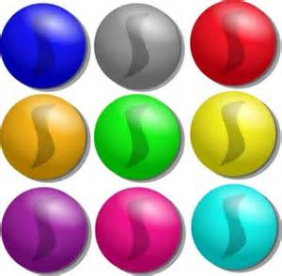

Slide 7
+

Slide 8
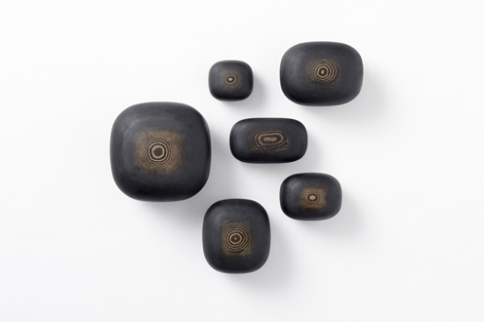

Slide 9
+

Slide 10
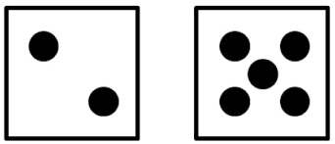

Slide 11
Underlying characteristics to Math LD*
What are some of the problems you’ve noticed that your
children with math LD cannot do, or struggle to do?
visual-spatial confusion
sequencing difficulties
organizational difficulties
Difficulty making sense of multi-step problems
Short and long term memory difficulties
Difficulty seeing patterns
Slow processing speeds
Inability to tell time
Language processing difficulties
* Specific Learning Disorder with Impairments in Mathematics

Slide 12
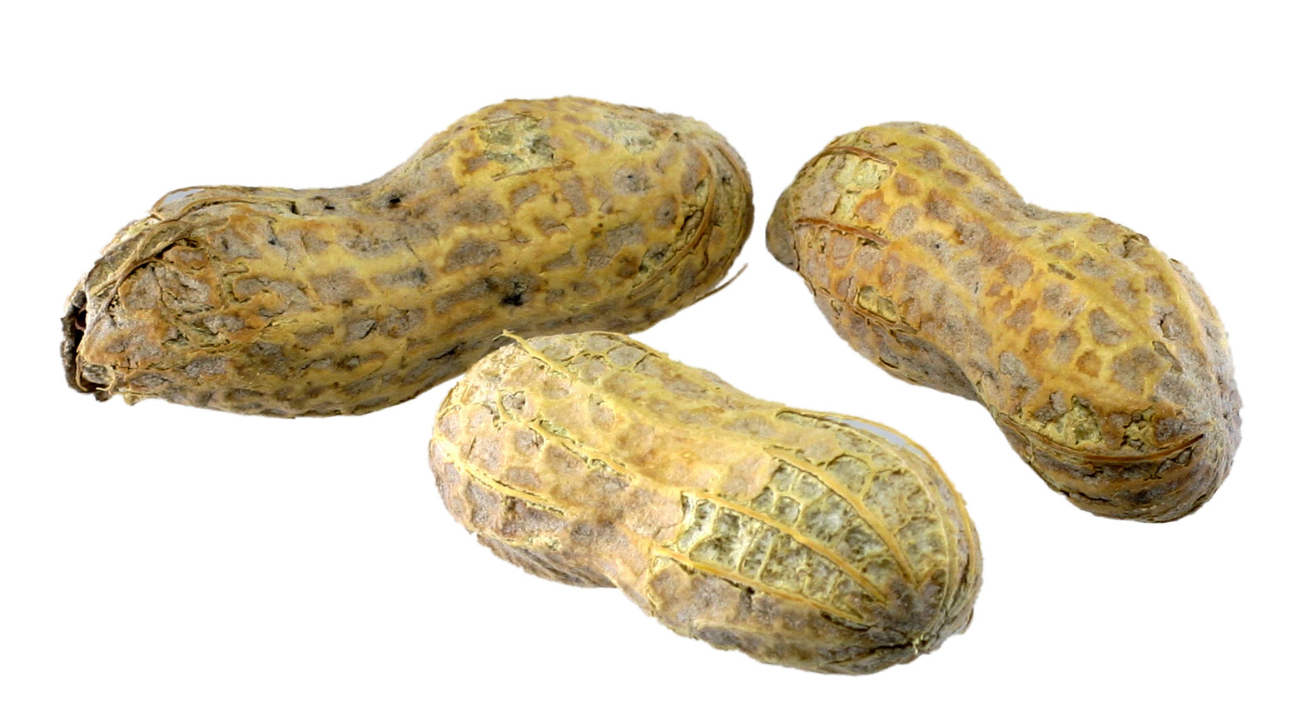
Counting Knowledge
1. Subitize 4. cardinality
2. One-to-one correspondence 5. abstraction
3. stable order 6. order irrelevance
Strategy: standard direction and adjacency

Slide 13
Arithmetic
During early development children tend to count both
addends (6 + 3)…with/without finger counting and with
verbalization = normal
Counting on & Counting all are also early normal strategies

Slide 14
Accurate conceptual understandings
+ good retrieval of basic facts
+ confidence
= Fluency/Automaticity

Slide 15
arithmetic
the branch of mathematics dealing with the properties and manipulation of numbers
the use of numbers in counting and calculation
The core deficit is the processing of numbers: arithmetic
“Numbers do not seem to be meaningful for dyscalculics…
they do not grasp the size of a number and its value
relative to other numbers. This basic understanding
underpins all work with numbers and their relationships to
one another.” (Butterworth, Varma, & Laurillard, 2011. p.1050)

Slide 16
“…many children with Math LD do not show the
shift from procedure-based problem solving to
memory-based problem solving that is commonly
found in typically achieving children, suggesting
difficulties in storing arithmetic facts in or accessing
them from long term memory” (Geary, 2004, p.8).
processing—memory and retrieval—number sense
Immature/procedural poor, delayed, inefficient, uninhibited undeveloped

Slide 17
Why?

Slide 18
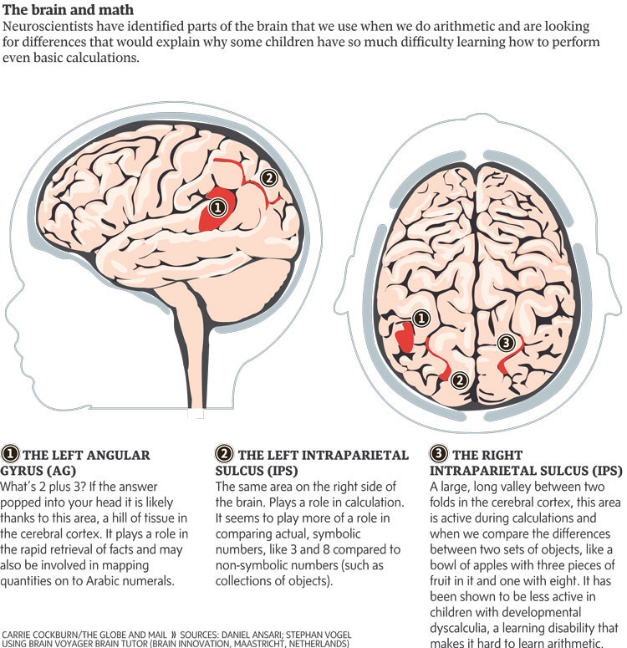
1. Left Angular Gyrus
It plays a role in the rapid retrieval of facts and helps map the quantity to the name of the number
O O
O = 3
Left and Right (2, 3) Intraparietal Sulcus
These regions play roles in comparing
objects/numbers, and counting sets and
calculating quantities.
Shown to be less active in children with Math
LD

Slide 19
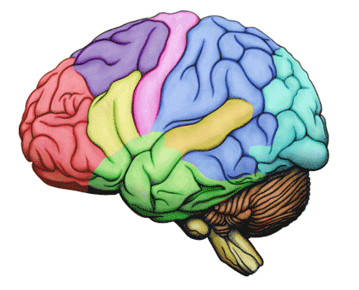
Reduced activation in parietal area of the brain…
reduced gray-matter density in parietal area, an
area known to be responsible for basic numerical processing
and reduced connections across sections of the brain that
help information transfer from short to long term memory
and deal with symbolic number form
Retrieval deficits of basic facts, and suppression of irrelevant
information
Notes:
Processing and retrieval deficits.

Slide 20
So now what?
“Targeted intervention that focuses on improving
these students’ general arithmetic including procedural
skills and knowledge about relations between
quantities (i.e., number sense) may be a necessary
first step to improving math problem-solving skills.”
(Tolar, Fuchs, Fletcher, Fuchs, & Hamlett, 2014, p.15)
“Strengthening the meaningfulness of numbers, especially
the link between the math facts and their meanings is
crucial…without specialized intervention, most dyscalculic
learners are still struggling with basic arithmetic in
secondary school” (Butterworth, Varma, & Laurillard, 2011, p.1051)

Slide 21
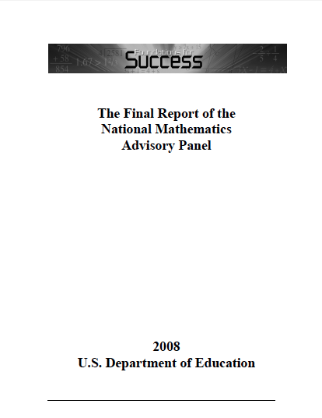
www.centeroninstruction.org
www.ed.gov/pubs/edpubs.html

Slide 22
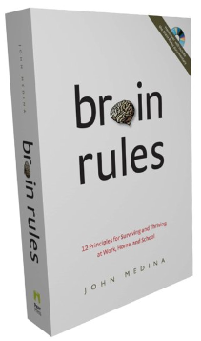
You can access this from http:/ncer.ed.gov

Slide 23
Butterworth, B., Varma, S., & Laurillard, D. (2011). Dyscalculia: From brain to education. Science, 332,
1049-1053. doi: 10.1126/science.1201536
Geary, D. C. (2004). Mathematics and learning disabilities. Journal of Learning Disabilities, 37 (1),
4-15. doi: 10.1177/00222194040370010201
Morgan, P. L., Farkas, G., & Maczuga, S., (2014). Which instructional practices most help first-grade students with and without mathematics difficulties? Educational Evaluation and Policy Analysis, 20, 1-22. doi: 10.3102/0162373714536608
Price, G. G., & Ansari, D. (2013). Dyscalculia: Characteristics, causes, and treatments. Numeracy, 6 (1),
1-16. doi: 10.5038/1936-4660.6.1.2
Swanson, L., & Sachse-Lee, C. (2000). A Meta-analysis of single-subject-design intervention research
for students with LD. Journal of Learning Disabilities, 34 (2), 114-136. doi: 10.1177/002221940003
300201
How can you get the most out of these sources?
http://dx.doi.org/10.3102/0162373714536608

Slide 24
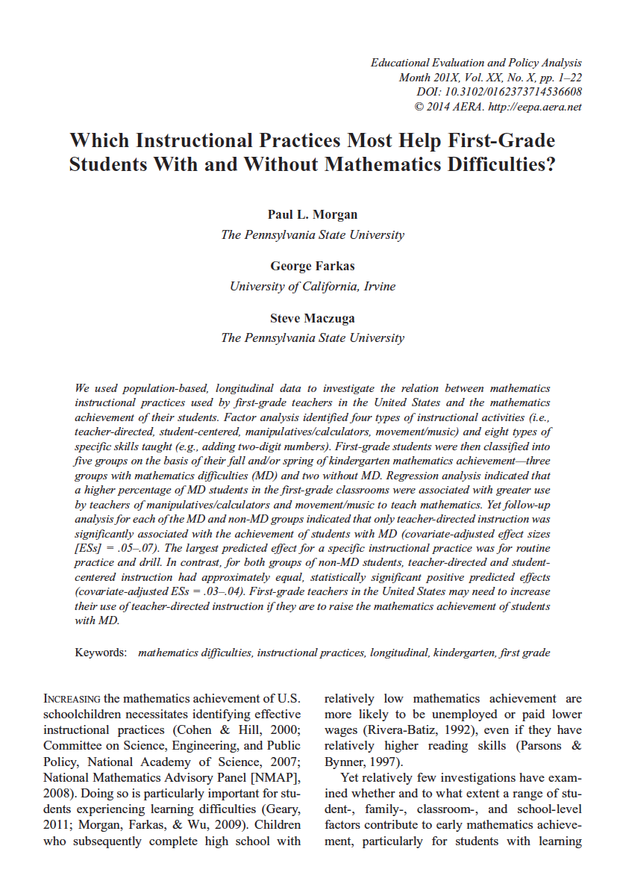
Approaches to Instruction

Slide 25
Morgan, Farkas, & Maczuga, 2014
Research Study
Student participants were divided as MD or non-MD
Students with MD: n = 2,486
Students without MD: n = 10,907
3,635 classrooms in 1,338 schools
Examined student trajectories/growth
Each of the 13,393 students received a large battery of tests:
Math achievement tests, reading achievement tests, Learning-related
Behaviour measures (ie. attention, persistence), School/family/student and
classroom variables too.

Slide 26
Results
What sort of teaching practices caused students with MD
to experience the greatest degree of growth?
“Only teacher-directed instruction was significantly
associated with the achievement of students with MD”
“The largest predicted effect for a specific instructional
practice was for routine practice and drill”
“Teachers may need to increase their use of teacher-directed
instruction if they are to raise the mathematics achievement
of students with MD.”

Slide 27
Approaches to Instruction
1. Explicit Instruction
“Explicit instruction that incorporates step by step-by-step,
problem-specific instruction resulted in increased gains in
math performance for LD students*”
Model and demonstrate out to the solution
Verbalize explicitly your thought processes & procedures
Have the student verbalize every step
Provide LOTS of practice and corrective feedback
AND corrected practice
*I apologize for lack of people-first language used in these research studies

Slide 28
Worked Example Solutions
“When teaching mathematical or science problem solving, we recommend that teachers interleave worked example solutions and
problem-solving exercises—literally alternating between worked examples demonstrating one possible solution path and problems that the student is asked to solve for himself or herself—because research has shown that this interleaving markedly enhances student learning.”
SOLVE for x: 5 +3x = 20
Below is an example solution to the problem:
Solve for x: 12 + 2x = 15
Study each step in this solution, so that you can better solve the next problem on your own:
12 + 2x = 15
2x = 15-12
2x = 3
x = 3/2
x = 1.5
It is suggested that at the beginning of a new skill you provide one worked example for each problem…a 1:1 ratio. You reduce this over time. To differentiate you maintain this ratio for students who need it.

Slide 29
Approaches to Instruction
2. Get Visual: Visual Representation
“Vision trumps all other senses”
“Visually representing math problems (e.g., graphics,
diagrams) had positive benefits on student mathematics
performance”...teacher-selected visuals showed greatest
effect
Visuals were even more powerful when they were used
as part of explicit instruction and the teacher referred to
it often...and the use of it was combined with verbalization
Use for math skills, math procedures, organization, etc

Slide 30
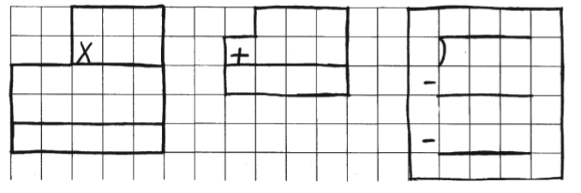
Graphic & Visual Organizers & combine graphics with verbal descriptions
“It is recommended that teachers combine graphical presentations (e.g., graphs, ﬁgures) that illustrate key processes and concepts with verbal descriptions of those processes and concepts in order to facilitate student learning”.
Source: Allison J. Fahsl

Slide 31
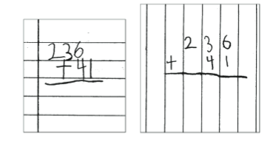
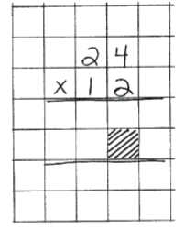
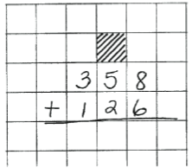
Organizing work
Highlighting work

Slide 32
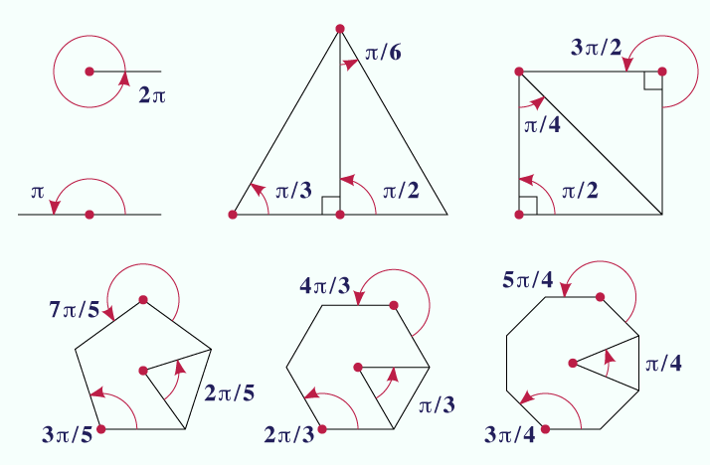

Slide 33
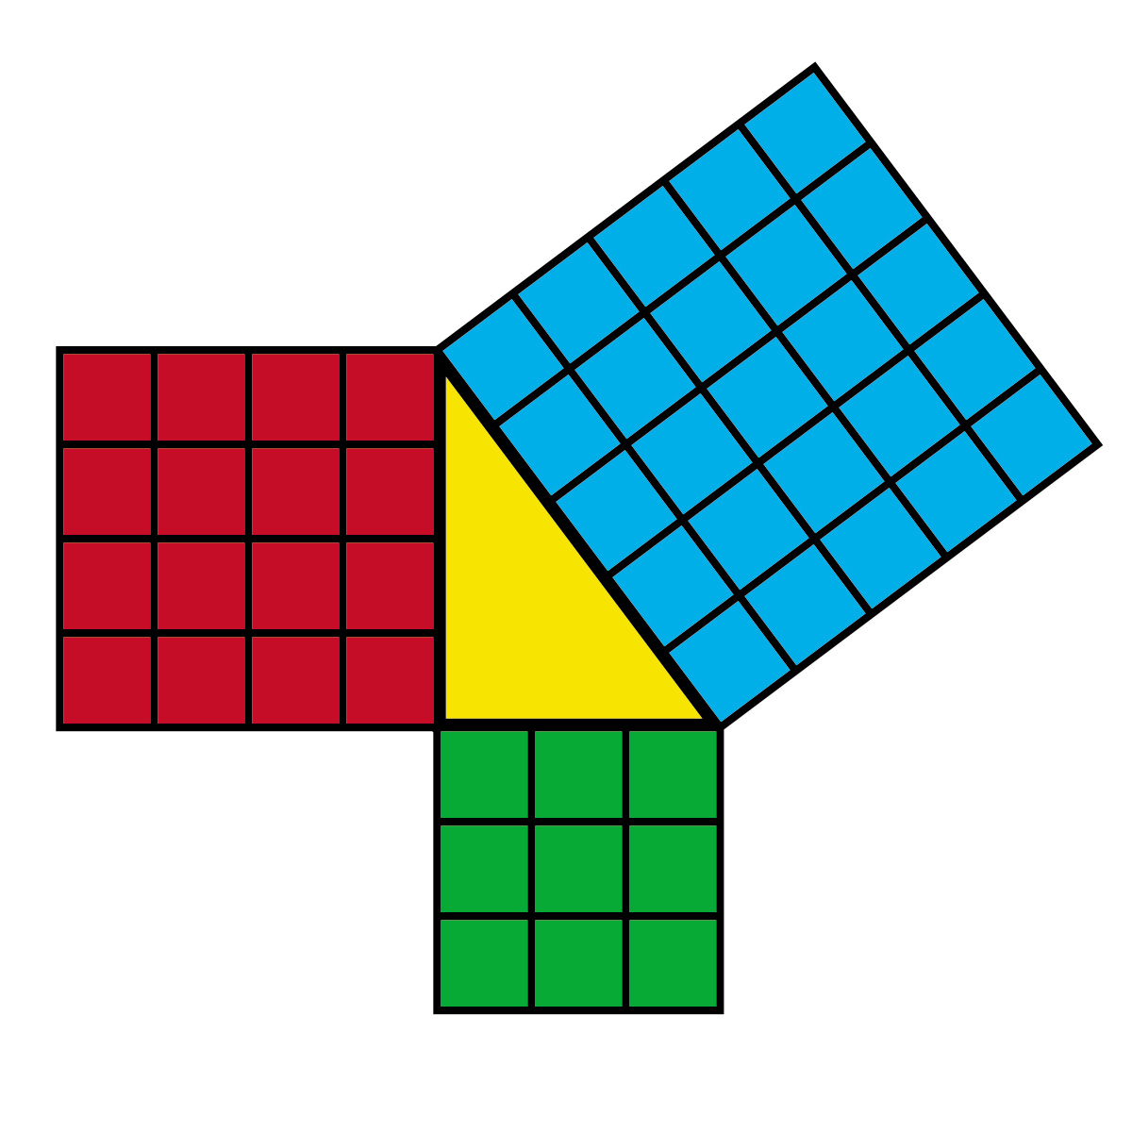

Slide 34
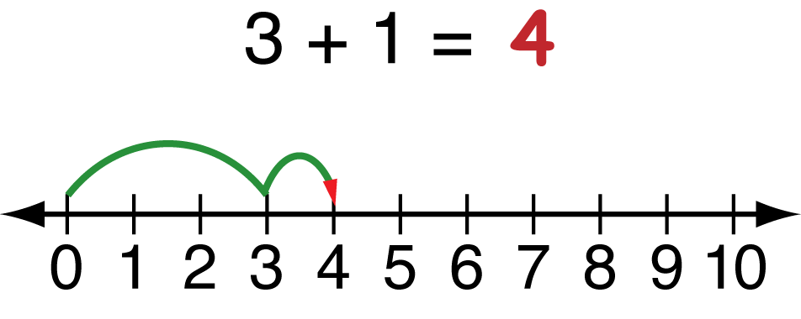

Slide 35
As a part of visual representation, research
has clearly shown that enhanced use of
anchor charts is effective

Slide 36
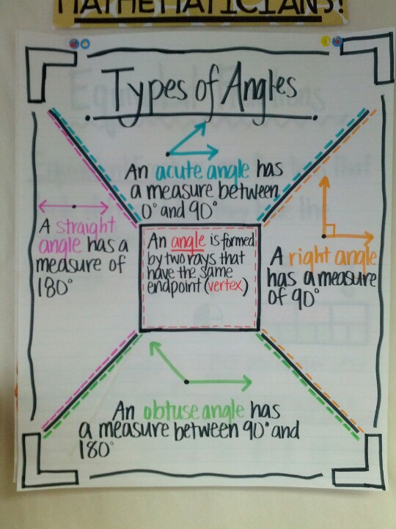
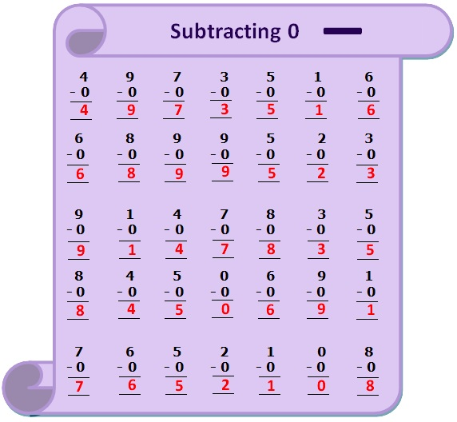
Anchor charts

Slide 37
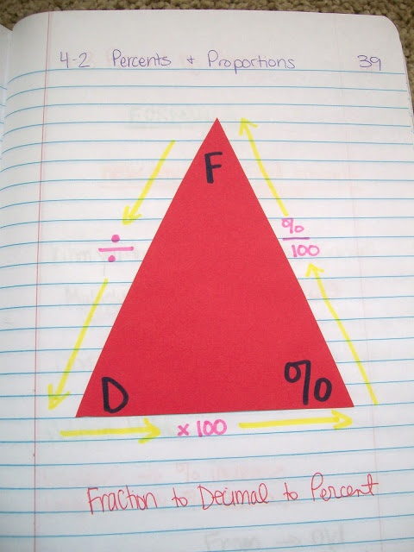
mathequalslove.blogspot.ca
Easy graphics
foldables
Interactive notebooks

Slide 38
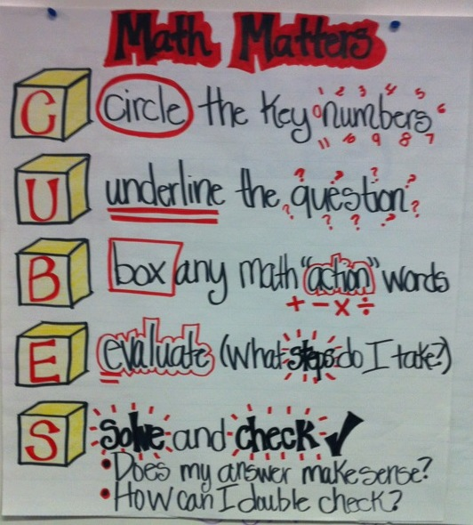

Slide 39
Approaches to Instruction
3. Teach and Use Heuristics
Heuristics are general problem solving guide in which the
strategy (list of steps) is not problem specific”...but can apply
across many types of math problems (as illustrated in last slide)
Highlighting your work
Find each sum or difference.
46 11. 84 12. 648 13. 617 14. 3,021
+ 21 -21 - 317 +121 - 230
Round each number to the greatest place. Then estimate.
37.9 5. 45.342 6. 794.04
+49.3 - 16.98 - 17.8
Notes:
Heuristics are best understood and best used by students who already understand the math concept but simply cannot remember the steps to complete the problem (Burns, 2011)

Slide 40
Approaches to Instruction
3. Teach and Use Heuristics
Heuristics are best understood and best used by students who already understand the math concept but simply cannot remember the steps to complete the problem (Burns, 2011)
(FOIL) BEDMAS SOHCAHTOA
“Read the problem, highlight key words, circle the signs,
check your work”
Notes:
Heuristics are best understood and best used by students who already understand the math concept but simply cannot remember the steps to complete the problem (Burns, 2011)

Slide 41
Approaches to Instruction
4. Progress Monitoring: Teacher/student
Frequent & systematic formative assessment,
with corrective feedback, is beneficial for the teacher and
the student.
The student must be central to this progress monitoring
Teachers and students must view performance data as part
of their normal teaching and learning regime
An important part of the formative assessment is the message
the teacher sends about progress through effort!

Slide 42
Approaches to Instruction
Attribution Effects
...emphasizing that effort and correct strategy
use yield results
Blackwell, Trzesniewski, & Dweck, 2007
The belief that intelligence is malleable showed an upward
trajectory in math achievement scores over the two years
of Junior High school, while a belief that intelligence is fixed
showed a flat trajectory (p.246)

Slide 43
Quick Review of the 5 Approaches
1. Explicit Instruction
2. Get Visual
3. Teach and Use Heuristics
4. Progress Monitoring
Attribution Effects

Slide 44
New Mathematics
Assistive/Instruction Technology
Designed by teams of neuroscientists
for the purpose of addressing the needs
of students with a learning disorder in mathematics

Slide 45
http://www.number-sense.co.uk/numberbonds/
Grade 5-7

Slide 46
www.low-numeracy.ning.com

Slide 47
A pilot project is currently underway in the NLESD

Slide 48
Contact Information:
Dr. Chris Mattatall
Website: www.faculty.mun.ca/cmattatall
email: cmattatall@mun.ca
Twitter: @ChrisMattatall
Look me up, let’s connect
Office phone: 709-864-7617

