Slide 1
Lessons I Learned in Prison:
Teaching, Learning & the Human Condition
Dr. Chris Mattatall
chris.mattatall@uleth.ca
@chrismattatall
Notes:
This is not a light hearted presentation. There are some difficult moments and some difficult topics here. These are also MY personal experiences and observations.
I am not trying to say that all of you need to believe as I believe, or adopt my way of thinking. This is a story. A story of how prison changed who I am. A story of how
people changed how I think and how I view my profession as my calling.

Slide 2
Notes:
When I first began my teaching career there was a glut in the teacher supply in Fredericton, N.B. where I lived. The city of Fredericton alone had nearly 450 substitute teachers on call, or so I was told. It was very difficult to get a job.
One morning at a lakeside camp, while sitting on a rock near the waters edge, I decided to do something about the bleak outlook on finding a job in the teaching field.
I decided that I’d better do something to pad my resume so I took a Laubach Literacy course on how to teach reading. I didn’t know anything about remedial reading. I thought it was simply a matter of following a handbook or something.
The course took place on a Saturday at an elderly woman’s home. She loved teaching this course. She took us through the handbook, took our $25 and waved at us as we walked out her driveway to the growing unemployment ranks of teachers in the city.
This wasn’t enough.

Slide 3
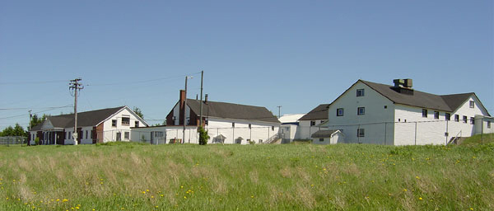
Lessons I Learned in Prison: Teaching, Learning & the Human Condition
Kingsclear Youth Training Centre
Notes:
It was time to do something with this newfound training so I visited the local youth jail outside of Fredericton and asked if they needed a volunteer to teach youth to read. I didn’t know what I was doing, but I thought I could put the Laubach training to work.
I don’t think they hesitated 5 seconds and said, “Yes, see you Tuesday night. We have just the fellow you can start with!!” Their chuckles should have alerted me to something, but I was desperate, so I agreed to come Tuesday night and tutor the student they had for me.

Slide 4
Notes:
That's when I met Randall. Randall was probably the most frightening teenager I have ever met in my life. I heard him before I saw him. Well that's not fair, I actually heard the guards bringing him down the hallway to the cafeteria where I was to teach him how to read. There was one guard on each side of him and they were telling him to behave if I recall correctly. He sat down beside me and acknowledged that he did indeed want to learn to read. I said, “great let's get to work”. And I began.

Slide 5
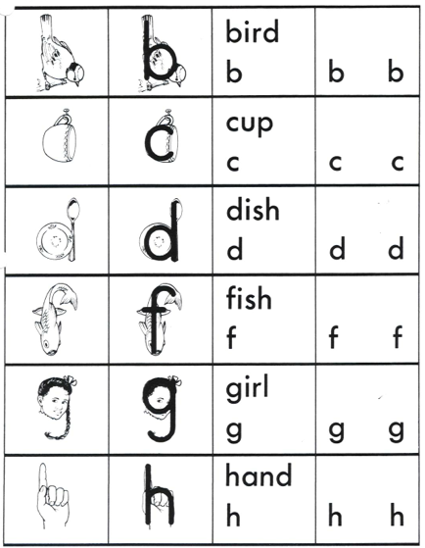
Notes:
I never knew then that I would teach the Laubach reading course for a total of 14 words. I didn't say 14 minutes, or 14 hours, or 14 days, or 14 months; I literally mean 14 words. And that was the end of it.
It started and ended like this: “This is a bird with a long back and a round body, say bird!” Silence. More silence. He looked at me and said, “you've got to be f#%*ing kidding”.
I didn't know what to say so all I did say was, “no, um, just say bird!” He then said, “do you see that food up on the ceiling over there?” There was a smattering of food splashed or thrown all over the ceiling in one section of the cafeteria. I said, “Yes, I see that food”. “That's what I do when I freak out,” he said, and stood up from the table and left the room, asking the guards to return him to his unit. And that was it.
Total failure. Total embarrassment. I learned my first lesson.

Slide 6
Lesson 1:
Failure is a part of
learning.
We often learn more from initial
failures than we do from initial
successes
...be the best student in the room
Notes:
The key....be the best student in the room. The best teachers are the best learners, and it never ends. Keep a learning mind...know that you never stop learning and it has a great impact on how good of a teacher you will be.
Amazingly after the Randall Scandal (OK that's a little over the top), the training centre administration called me up and asked if I would be interested in taking a class of misfits, a group of seven boys who could not read and who left school. They affectionately became known as the group of seven. We did tons of fun and interesting things and we turned play into learning; for example we built topographical maps out of paper mache to teach them about geography, We painted maps on the wall to teach them where they lived, we did fun and entertaining writing exercises to encourage them to write, and I read to them every day.
Then, when the training center shut down, I was invited to work at the new New Brunswick Youth Centre, a maximum security youth prison in Miramichi, NB. I accepted the job.

Slide 7
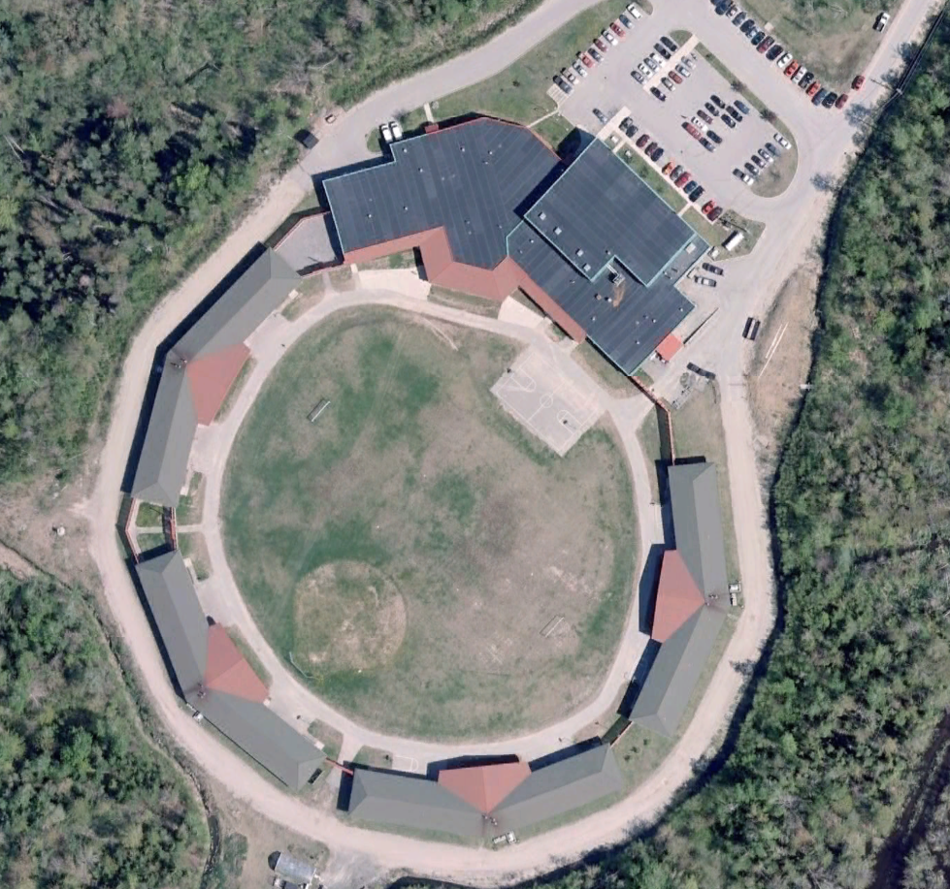
Notes:
NBYC: A maximum security youth prison for young offenders
I thought I was a pretty good teacher before coming to NBYC. I was creative (ceiling in FHS), I was hard working, I was liked by students and staff (I think) and I tried to be as innovative and current as possible. I was a good student I think...and I was humble.
AND THEN HE ARRIVED.

Slide 8
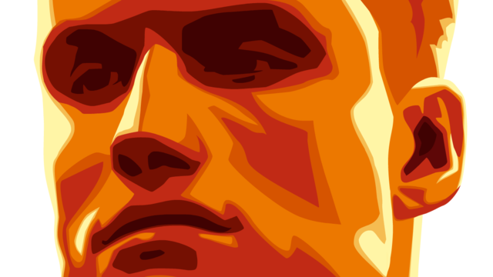
Lessons I Learned in Prison: Teaching, Learning & the Human Condition
Notes:
Freddie was the type of student everyone fears having. He had severe ADHD, he was obnoxious, mean-spirited, disliked by everyone. Freddie couldn’t walk across the room without insulting someone...he had a strut and a mannerism that begged to be challenged. He disliked everyone and trusted no one...and everyone dislike him. What a miserable student! I couldn’t stand him. He is the only student I can say that I “hated”. I’m ashamed to admit this, but I couldn’t stand him and wanted him out of my class. I secretly wished he’d get in a fight on the unit and be locked up in his cell or solitary confinement for the rest of....well, his life. I developed a very strong dislike for this boy....but this gnawed at me....so I asked one of our prison psychologists, a friend of mine, if I could talk to her about Freddie.
She listened to my complaining and concerns about this boy and my growing frustration and dislike for him. I spoke for about 5 minutes....she remained silent. Finally she spoke: “read his file.”
I didn't want to read his file. I knew the type of kid he was. Or at least I thought I did. I protested several times but she kept returning to the same advice, read his file, read his file, read his file. eventually she made me promise that I would go and read his file because for reasons that I can't remember we had that afternoon off from teaching so I had all the time in the world to go and read his file.
And I did. And my life was changed. Forever.
Most young offenders, I think, have one or two five-inch D-ring binders that contains their criminal history, psychological history and so on. Freddie had four. To keep up my end of the bargain I reached out and grabbed providentially perhaps one of the four binders. I flung it open and simply began reading where my finger landed. What I read was a story of a young boy who from a very early age of being diognosed with ADHD couldn't seem to catch any breaks. He simply wore out his welcome everywhere from the age of kindergarten to when he was removed from school in middle school. His severe behaviors caused cracks in his family, in his school, and with all of his friends. It would be safe to say that he was disliked by everyone, and he knew it. One day this frustration boiled over on the part of his father, and his dad physically abused him in a severe way, landing Freddy in the hospital with severe burns. Freddie broke. Reading the account of freddie's early life, difficulties, challenges, broken relationships, failure at school, and abuse, caused me to have a profound paradigm shift in how I viewed this boy. At the very point of reading his full story, I broke down and was unable to speak for several days, and I can safely say that I fell in love with this boy.

Slide 9
Lesson 2:
Teachers must
allow love to be
part of how they
think...
Lessons I Learned in Prison: Teaching, Learning, Grace & the Human Condition
Notes:
We don’t talk much about LOVE as a necessary part of teaching preparation, but we must. We must love our students. We must use a filter of love when we consider them. We must allow the power and strength of love to transform our service to students; from obligation to desire to love them. There is a power to love that’s unexplainable. There is an effect to love that contagious and life changing....for you, and for your student.

Slide 10
Lesson 2:
Teachers must
allow love to be
part of how they
think...
Lessons I Learned in Prison: Teaching, Learning, Grace & the Human Condition
Notes:
A few years ago I heard a fellow by the name of Gary Smalley talk about the type of love that he represented with a great diamond. He held up this gigantic two pound glass replica of a diamond and said wouldn't you love to have a diamond like this wouldn't this show a great deal of love to your partner if you presented them with a gigantic diamond like this shouldn't we be treating our partners as the most precious thing that has ever existed shouldn't we show love like this to one another imagine the power of love if we treated each other like this. His analogy had a great effect on me. Imagine if I treated each of my students like a precious diamond that was of great value. Well they are of great value, and so am I.
Self-love too.
Too many teachers beat themselves up for things they cannot control
Until you learn to see things through a lens of love, you may not truly see the child for who he is or can be.
I don’t believe I need to go into this much, really. We all know that science has shown that love, feelings of being loved and accepted, and feeling that someone cares deeply for you has tremendous benefits psychologically and physically. However, we avoid ever talking about it...and rarely do you hear conference speakers say, “if you want to be a great teacher, work on how much you love your students.”
You know, of course, I am talking about respectful, appropriate love for your students...but I am also saying that we need to cultivate it...not be afraid of it, and work to expand it.

Slide 11
Lesson 2:
Teachers must
allow love to be
part of how they
think...
Lessons I Learned in Prison: Teaching, Learning & the Human Condition
“People don’t care how much you know until
they know how much you care”
Notes:
I know it’s a well-worn statement, but it is indeed true that people don’t care how much you know until they know how much you care. Freddie, or any of my students for that matter, wouldn’t listen to much of what I had to say, or invest in their learning, if I hadn’t first loved them and showed them that I cared. This takes time in most cases, of course, but we still need to set out to be those types of teachers who desire to love their students.

Slide 12
Lessons I Learned in Prison: Teaching, Learning & the Human Condition
Notes:
In their influential book called Raising Resilient Children by Dr. Robert Brooks and Dr. Sam Goldstein, they describe their research that showed the characteristics of resilient children. One of their key findings was that children who made it through significant stress and alarm had a significant other in their life whom they could depend upon and be loved by. They likened it to people holding up the corners of their trampoline so they could jump higher or reach higher heights. Every child needs people in the corner of their trampoline to hold it up for them. Teachers are often called upon to be those significant others in the life of children
In Alberta, one of the highlights and acknowledgements in the high school redesign is the central role that relationships play in schools between teachers and students. Relationships involve trust, respect, honouring that person for their best interests. That’s love.

Slide 13
Lessons I Learned in Prison: Teaching, Learning & the Human Condition
“My students are not an interruption to my day; they are the purpose of my day!”
Notes:
One day my wife and I were talking about her caseload (she’s an OT) and she mentioned that she had a particularly busy day answering phone calls from clients and family members. I said, “Oh, that must really interrupt your paperwork when your clients call you?” She quickly corrected me: my clients are not an interruption of my day, they are the purpose of my day. I stole her saying here....it applies wonderfully to our teaching and time in school.
Teachers are incredibly busy. You know that. Students will on a regular basis want to talk to you, interrupt your marking or planning (or breathing!)....they are not an interruption. They are the very purpose for you being there.

Slide 14
Notes:
Meet Samuel....with a glimmer of talent, a glimmer of potential and leading in his area, WE jumped all over it and encouraged him, surrounded him with support and resources, and helped to develop his skill further by arranging for him a professional art lesson, having him use his talent to teach an art class, and eventually he hosted an art exhibit outside of the prison for the public and sold his art work for a lot of money. I want to give a shout out here to the mastermind behind this great idea; John Tingley. John is a terrific advocate for students and he continues to lead by example in New Brunswick.
Where is Samuel now? Actually, I cannot tell you. Samuel (not his real name) is actual a successful business owner, he started his own company (whose name I cannot tell you) but I looked him up yesterday on the internet and he is doing very well. In fact, he has returned to NBYC as a guest speaker to young offenders there.
This is what love does. This is what influence can do...it is contagious, it spreads, it creates.

Slide 15
Lesson 3:
You succeed
when others
succeed
Notes:
Samuel....with a glimmer of talent, a glimmer of potential and leading in his area, WE jumped all over it and encouraged him, surrounded him with support and resources, and helped to develop his skill further by arranging for him a professional art lesson, having him use his talent to teach an art class, and eventually he hosted an art exhibit outside of the prison for the public and sold his art work for a lot of money.
Where is Samuel now? Actually, I cannot tell you. Samuel (not his real name) is actual a successful business owner, he started his own company (whose name I cannot tell you) but I looked him up yesterday on the internet and he is doing very well. In fact, he has returned to NBYC as a guest speaker to young offenders there.
This is what love does. This is what influence can do...it is contagious, it spreads, it creates.

Slide 16
Notes:
Art was one of those areas that John Tingley used for Samuel to fuel potential and a new way of thinking about himself. Samuel saw a new path based on the belief of someone in him.

Slide 17
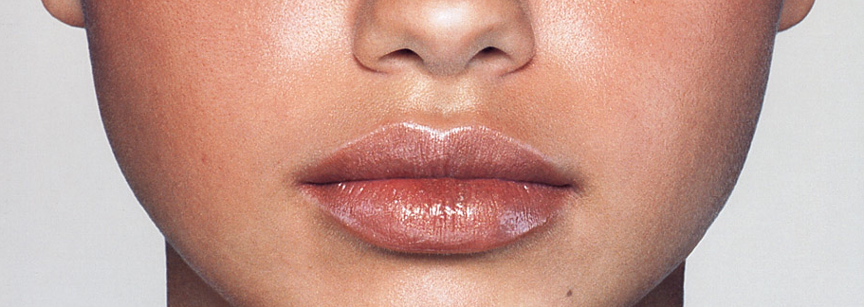
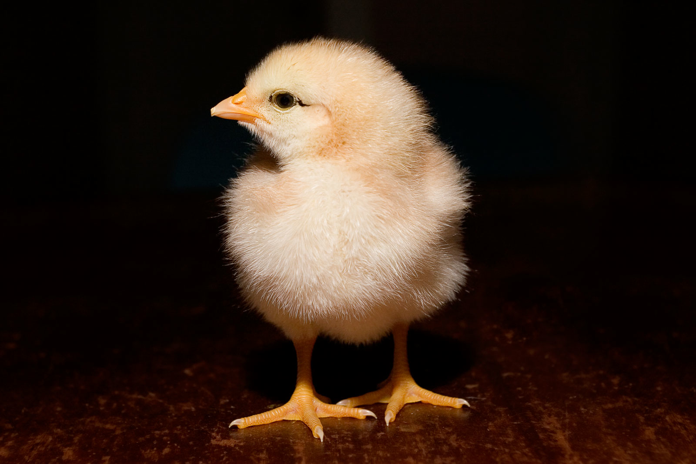
Out of the Dark
A Story of Renewal, Hope and Youth Voice from Inside Prison
Notes:
We decided to try something new with these kids...a theatre company. A theatre company? Yeah, well I saw what Famous People Players did with children who had intellectual disabilities and I thought, ‘well, if they can do it with those kids, then I can do it with my kids.’
Blacklight Theatre Company did shows in schools, did children’s shows in the prison...we brought the little grade 1s in to our chapel to do a Christmas show and we brought the public into our gymnasium to do a Remembrance Day show.... and we toured the province.
Young offenders out in schools?
How do you think my kids felt when they received standing ovations?

Slide 18
Out of the Dark
Notes:
Our Black Light Theatre Company had as its logo a BLT sandwich (BLT= black light theatre). Our first show was called Out of the Dark and there's a very good reason why we gave it this name. There is a story told of a Prairie farmer who experienced a horrific wildfire at his farm, a grass fire, that swept the Prairie and destroyed his house and barns. Distraught this farmer walked across his land as he cried. Seeing a pile of black burned hay he kicked it. Out from beneath this pile of hay, which actually turned out to be a mother hen's body, sprung a group of bright yellow chicks. This new life sprung out of the dark in a similar way that are young offenders felt that they were springing out of darkness themselves, and trying to help other teenagers do the same.

Slide 19
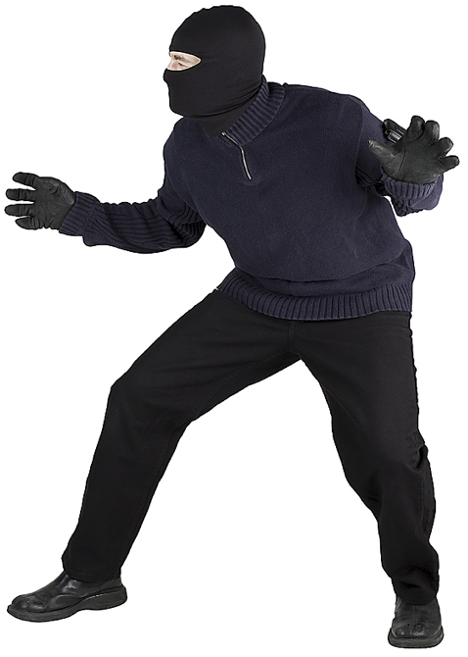
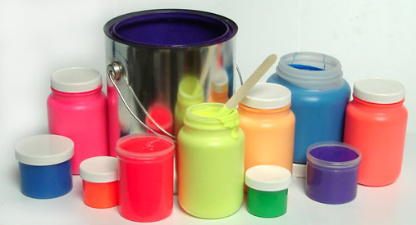
Notes:
Here’s our logo, and an idea of how our actors dressed (in black) and the types of props we used and the fluorescent paint we used.

Slide 20
Notes:
This is a rehearsal picture of one of our plays. You may not be able to tell, but those ‘puppets’ are 6 feet tall and you can make out the face of one of the actors behind the white-haired puppets head.

Slide 21
Lesson 3:
You succeed
when others
succeed
“Nothing breeds success like...success”
You lose nothing by making sure others function at their best

Slide 22
Lesson 3:
You succeed
when others
succeed
“Do no withhold good from those to whom it is due, when it is in your power to act”
Proverbs 3:27
The “Golden Rule” is a principle of spiritual and personal growth...we are to serve so that we grow

Slide 23
Lessons I Learned in Prison: Teaching, Learning, Grace & the Human Condition
Notes:
Chuck was one of the most unusual and interesting people I have ever met. He was the living embodiment of Homer Simpson...funny.
Learned to read at 16... I won’t put into print his story here, but let me tell it to you.
Contacted me this summer....successful, has a loving partner, owns his own truck, boat and house....and fishing business.

Slide 24
Lesson 4:
There’s no such
thing as average
and that’s a good
thing
Lessons I Learned in Prison: Teaching, Learning, Grace & the Human Condition
Notes:
“Human Beings are deeply troubled about being human” Martha Nussbaum
“Great variability is the characteristic that best describes the human condition” Todd Rose
No cookie cutter approach to teaching students.

Slide 25
Lessons I Learned in Prison: Teaching, Learning & the Human Condition
Notes:
Read passage from The End of Average.

Slide 26
Lessons I Learned in Prison: Teaching, Learning & the Human Condition
Notes:
Read passage from The End of Average.

Slide 27
Lessons I Learned in Prison: Teaching, Learning & the Human Condition
Faith
Giving
Bible reading
Service
Doubting
Forgiveness
Patience
Grace
Joy
Peace
Notes:
Read passage from The End of Average.
We must think deeply about this....there isn’t a one-size-fits-all to real human beings, so there can’t be a one size in teaching. Individualization, differentiation. It is hard work...but it’s necessary and meaningful work.

Slide 28
Notes:
This is not a light hearted presentation. There are some difficult moments and some difficult topics here. These are also MY personal experiences and observations.
I am not trying to say that all of you need to believe as I believe, or adopt my way of thinking. This is a story. A story of how prison changed who I am. A story of how
people changed how I think and how I view my profession as my calling.

